Slide 1
Ports and Maritime Organization
Project Iran
27-28-29-30 September 2015

Slide 2
AGENDA
Ports and Maritime Organization (PMO)
Tehran, 27 September 2015 - 10:30-12:00
Participants:
Managers and senior experts from PMO, terminal operator and other private sector companies involved in port and maritime activities in Iranian ports.
Part 1:
Course Material:
Container terminal safety
With special focus on loading, discharge, stuffing-stripping, lashing and handling at port area providing similar cases of the most safe and busies container ports in the world and references to respective international rules and regulations such as IMO's International Convention for Safe Containers (CSC).
Part 2:
Tehran
27 September 2015 - 14:00-18:00
28 September 2015 – 8:00 -17:00
Course Material:
Regulations of testing, inspection, approval and maintenance of containers covering structural safety requirements including details of test procedures with the following titles:
Introduction
Types of Containers
Standard Container parts
Acceptance and rejection of the containers
Inspection & Repair methods, Safety certification and ACEP
Lifting, handling and forces
Lessons learned from container accident and damages
Part 3:
Bandar Abbas Port
30 September – 8:30-12:00
Continuation of the part 2 with providing cases and examples from the busiest container ports in Asia (such as Singapore) and Europe (such as Antwerp and Rotterdam) and implementation of the CSC Convention in these ports.
30 September – 14:00-16:00
Site visit of SHAHID RAJAEE container terminal and review the course materials in practice

Slide 3
Abbreviations mentioned in various sections of this presentation:
ADR European Agreement concerning the International Carriage of Dangerous Goods by Road
CSDS Chemical Safety Data Sheet DG Dangerous Goods
CSC Container safety convention
CTU Cargo transporting unit
DGL Dangerous Goods List
EDI Electronic Data Interchange
EDP Electronic Data Processing
ERP Emergency Response Plan
EMS Emergency Schedule
IBC Intermediate Bulk Containers
IICL Institute of International Container Lessors
INF Intermediate Range Nuclear Forces
IMDG International Maritime Dangerous Goods
IMO International Maritime Organization
MARPOL International Convention for the Prevention of Pollution from Ships
MSC Maritime Safety Committee
N.O.S Not otherwise specified
PRI Pesticide Risk Indicators
RID Regulations Concerning International Transport of Dangerous Goods by Rail
SOLAS International Convention for the Safety of Life at Sea
UN United Nations UNCOE United Nations Committee of Experts

Slide 4
Part 1 Container terminal safety

Slide 5
1-Safety in general To be able to create a more safe operational and work environment it will be of absolute importance that the General Management of the Port and Terminal operators take charge of all the aspects that influence the quality in general. It has been proven that besides the loss of lives and the costs of the damages and losses of cargo in general for all parties involved there is an after-backslash for the port or the operators ,when the clients decide to stop the cargo flows through the port that has had several reoccurrences of incidents and consequently bad management . It will be the shipping lines in the first instance that will abandon the port and with them one risks to lose quite a lot of yearly tonnage. The only viable option for the future is to adapt where necessary so that guaranties can be given to all concerned that the quality and safety rules are respected. 2-Requirements in sequence of importance The management must commit to improve the overall quality of the terminal operations and all other port related activities. Terminal Layout need to be reviewed and adapted to the actual and future requirements and the actual and future developments in the shipping business. The management must be familiarized with the modern techniques of handling bulk cargo and containers that will be passing their port. -All types of workers need to be able to take part in regular training sessions according to the job and position they occupy in the port organization -Terminal equipment needs to be in good working order or eventually replaced to be able to optimize the efficiency of the terminal. -Land space optimization -General regular maintenance programs will need to be set up to avoid breakdowns and certainly avoid accidents of any kind. -execute all activities according the International rules and regulations IMO – ISO –IMDG – CSC - IICL5

Slide 6
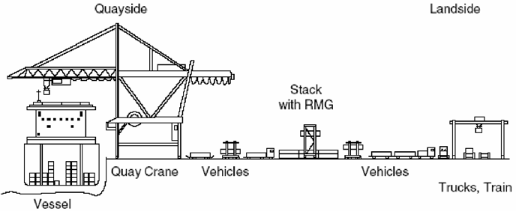
3-Loading and discharging of containers
GENERAL CONTAINER TERMINAL OPERATIONS
Function and operations of container terminal
Container terminals can be described as a system that links two external processes:
• Quayside process: water based transport
• Landside process hinterland transport (including inland waterways)
The primary function of a container terminal is connecting the water and land side transportation by
providing intermodal connections with all possible transport systems incoming /outgoing.
This process is schematized in above.
The traffic functions required at both interfaces are as follows:
-Loading and unloading of containers to and from vessels
-Storage for containers
-Verification of container information
-Checking or recording of container damage for incoming and outgoing containers
-Verification of container content
-Providing supporting services as explained in more detail below

Slide 7
Loading and unloading of containers to and from vessels
Container handling at the quayside and the landside is one of the core logistic and business of
container terminals.
When a ship arrives at the port, quayside cranes load and unload containers.
On the landside, terminals load and unload containers from other modes of transport such as trucks, trains and barges for further transportation to and from the hinterland.
Storage for containers full imports and exports and empty
Temporary storage is an essential function of a terminal in which the "Import" and "Export"
containers remain for a certain period of time awaiting transfer to the next mode of transport.
Perfect equivalence between the land and the sea side transport is not feasible for two reasons:
A-it is not possible in practice
B-because without a storage yard, the system becomes extremely vulnerable to any disturbance.
Therefore, after unloading at the seaside/landside, the containers are moved to the storage yard, by means of terminal tractors, straddle carriers or automatic vehicles.
The logistic process to/from storage yard in a container terminal is summarized in Figure below
Vessel arrival
Vessel loading
unloading
Vessel departure
Water
side
Storage yard
Land
side
Truck Train Barge
Arrival
Truck Train Barge
Load/Unload
Truck Train
Barge
Load/Unload

Slide 8
Verification container information
To ensure containers reach their intended destination safely and surely, an important function of a
terminal is to verify the containers information.
Prior to the development of the internet and other ICT applications, all cargo information related to the
containers was transferred by printed documents cargo manifests to the vessel at port of loading
Together with the cargo/containers and was again handed over upon arrival of the ship.
Today cargo-data is transferred faster via internet and to is available at the destination ahead of the
vessel/cargo.
This has enabled to increase the efficiency of containerization and to improve “handling operations ”
at arrival as well as “cost reduction” and allowed ports and stevedores to “plan much more ahead” of
time and allows all parties involved to take a close look ant what IMCO goods are inbound and determine
If they require to organize specific precautions for certain shipments or not.
Checking or recording of container damage
In long and complex transport chains, due to involvement of various parties, damage to the cargo may
occur. Therefore, damage inspection of the containers is carried out at two points; the entrance and the
exit of container terminals. This step is to determine the responsible party for the damage.
Verification of container content
In principle, the containers are not opened between the origins and the destination.
However, due to increase in the global flow of containers, containers are randomly selected based on
statistical and Intelligent methods for inspected (e.g. X ray scanning)
If scanning identifies suspicious items and the container will be unpacked for physical inspection.
It also might be that a box has leakage or structural damage and also this is then anticipated by actions
that prevent further deterioration of the situation on board or on the quayside.
Providing supporting services
Container terminals provide support services such as container repair, container cleaning, pre-tripping of
reefers to the shipping companies right or adjacent to the terminals and is how most of the shipping lines
are or like to operating worldwide today.
Sometimes the high price of land of waterside area’s is forcing these support services to a an area
outside the container terminal and are primarily privately owned companies that offer the full range
Of container related services sites near the terminals.

Slide 9
Container terminal layout
A number of elements are essential to a terminal but are forming a complex relationship
between those elements and can greatly influence the efficiency and profitability at a terminal.
For an example, a barge terminal can be planned perpendicular to the deep-sea quay.
It reduces internal transport distances and providing a more compact terminal layout.
Quay wall
The quays are the interface between a ship and the land.
Container vessels berth along the quay wall of the container terminal.
Quay walls for container terminals do not necessarily differ from quay walls for other vessel types.
Apron
The apron is an open area adjacent to the quay wall and the width of the apron varies from a
minimum of about 40m to more than 100m and often depends on the width of the crane rail track
and the type of horizontal waterside transport.
The apron supports two functions:
1-An area for quay cranes to operate on.
2-An internal traffic circulation area for vehicles moving containers between the quay
cranes and the storage area.
Storage Area
In the storage yard “import-export-empties-transshipment” containers need to be kept on terminal
for a certain period (dwell time) before these are moved inland or put on board of the departing
Vessels-trains-trucks-barges
For reefers and hazardous containers special areas with special equipment have to be considered.
It also includes a special area for stripping and stuffing of cargo called Container Freight Station (CFS).

Slide 10
4. Landside Traffic System
Landside traffic system enables trucks to bring and collect containers at container exchange points.
The trucks enter the landside area through the truck gate where administrative activities such as
inspection and recording the physical condition of containers are carried out.
The trucks then precede to the exchange points before exiting terminal.
Note to avoid grid lock inside and on public roads outside the terminal, sufficient queuing space has
to be included in the planning of the truck gate.
5. Buildings
Numbers of buildings are provided in a terminal for repair and maintenance of the equipment.
Although, most of the maintenance activities are carried out outside the terminals, workshops on the
terminals are unavoidable, since most of the equipment that operates in a terminal is too large to be
moved to external workshops.
In addition, every terminal needs office buildings for management, staff facilities and supporting the
total number of functions.
6. Other
In addition to essential elements described above, a number of other elements do exist at a terminal
As illustrated below on the next page.
Rail Terminal
Barge Terminal
Empty Container Depot
Container Repair and Cleaning Facilities
Container repair facility
Customs
CFS warehouse

Slide 11
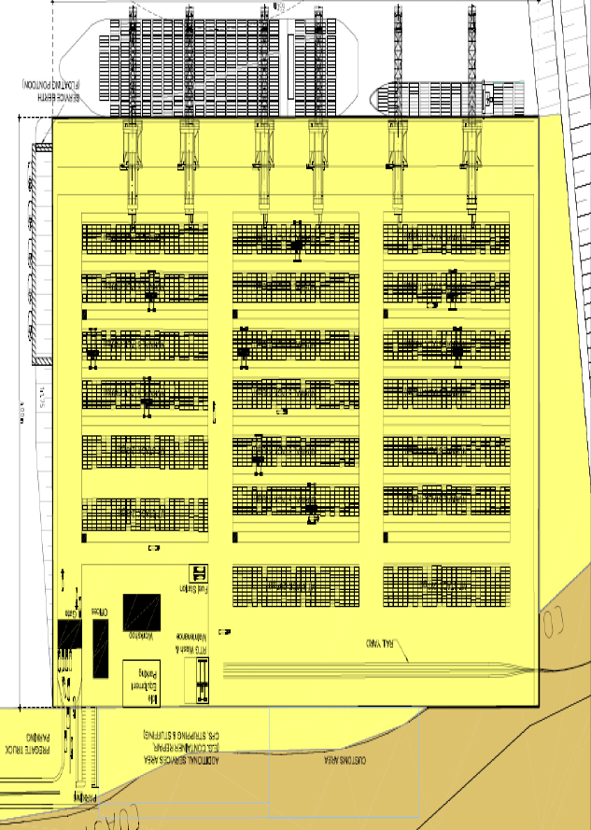
General Terminal layout and operational area’s
Rail yard
Rail
Customs area
Inspection area and bonded WHS
CFS WHS
Stripping & stuffing
Container repair & cleaning
Repair area container storage
CFS WHS
Container
Cleaning bay
Tool pantry
Offices
Truck gates In/out
RAIL YARD
Repair shop
Gates In/Out rail/truck
Customs area
Stacks empty containers
Load & discharge area boxes onto/from trucks
Stacking area’s
Water & quayside
Stacks full import/export containers
Water & quayside
ISO standard
6346 for container ID
CSC convention
Apron area
Safety standards
regulations
Imco goods
Regulations
Safety practice
berth

Slide 12
THE BASICS
TO MAINTAIN AND IMPROUVE ON SAFETY STANDARDS ON TERMINALS AS PRESCRIBED BY THE
IMO – ISO –IMDG – CSC - IICL5 WORLDWIDE STANDARDS
1-Undertake EXTENSIVE RESEARCH on all the operational elements and find the flaws that conflicts
with the International standards mentioned above.
2-REVIEW OR WRITE NEW PROCEDURES that reflect the basic general standards that are the general
guideline and make sure these are need maintained and updated year round.
3-CREATING AND ADJUSTING THE SECURITY AND SAFETY STANDARDS requires a TOP-DOWN
mindset and action and controls that make and keep the employees aware of the need to align and
maintain with the International standard rules within all types of operations.
4-TRAINING THE STAFF is one of the top priorities but in view of the fact that our business is full of
complexities at all levels, it is certainly required to create continuous training programs for all
the workers and employees that are involved in the various operational aspects.
5-A FOLLOW UP SYSTEM has to be set up in order to make sure there is a central control that steers
these training programs and can quickly intervene to make sure the quality of work and safety are
not going down but remain at the quality levels that are required.
6-TERMINAL EQUIPMENT is one of the primary backbones of a terminal operation and there is an
absolute need to ensure it is aligned and is working and used according to the standards and
conditions the port is guaranteeing to their clients.
7-REVIEW THE LAYOUT of the terminal regularly and try to make better use of the space,equipment
and human resources.

Slide 13
WHAT WILL THE FUTURE BRING US ?
1-Volumes will increase for the BIGGER gateway ports
2-The vessel routes are changing because of the entry of the very large container vessels
that became operational with the immediate consequence that these ships will call less ports
and that there will be a bigger concentration in the very big ports since these will function as
a basic ocean gateway for a larger hinterland.
3-The consequence of that will be that there will be a need of more inland transportation
systems like trucks/barges/feeders/rail on an intermodal basis that will have to bridge larger
distances overland.
This will cause also an increase of volumes through other regional ports that are the connection
ports for barge and feeder volumes and each service their close by hinterland.
4-All these elements will create a definite need for all Iranian Ports to align their methods
and quality of service to the requirement of their customer who will insist on more stringent
general contract conditions on quality and safety because they will want a steady quality and
safety end to end for the whole stretch the containers will move from origin to end destination.
5-It is of the utmost importance that the ports align themselves as quickly as possible if they
want to ensure cargo/containers will come their way.
The adherence and the execution of all port related activities according the International
rules and regulations IMO – ISO –IMDG – CSC - IICL5 will be one of the major facets
and one of the priorities.

Slide 14
STUFFING & STRIPPING OF GOODS IN A CFS AND OFF-DOCK
What is the function a container freight station – CFS
A container freight station (CFS) is a warehouse where goods are consolidated into or deconsolidate
from/into containers for transport to their next destination.
Where do the CFS fit in the importing/exporting process of the goods
If you purchased less than a container’s worth of goods, your shipment will head to a warehouse (CFS)
for consolidation in the origin country.
The shipment will be loaded into a container along with other people’s goods and taken on board
of an ocean going vessel to the port of the country of destination.
Once the container reaches the destination port it will be taken to a CFS and the goods are inspected
by customs and de-consolidated and stored ,all according to the regulations.
The warehouse will then store your goods until these are custom claired and can be released to the
consignee who orders his transport company or the local agent to pick it up and deliver it to his WHS.
What’s needed to pick up your goods from the warehouse (CFS)
The warehouse will need a copy of the following two documents :
-A Delivery Order, which will give them permission to release the goods to you or your
designated trucker or to the receiver directly.
-The customs clearance document which shows that Customs gave the green light for your
goods to be released to the receiver.
-Before the Consignee or his trucker picks up a shipment they will need to present the
clearance customs document to the customs officer and the CFS so they then can release
the cargo.
What are the consequences of such operations in the CFS ?
-A tremendous mix of types of general groupage cargo Non Hazardous and Hazardous IMCO
-In such operations the risk is very big and the CFS should be one of the first to be reviewed
to adhere to the international rules and regulations .
-The risks in bodily harm and loss of goods is or can be very important.
-A reason the more to make sure all is done as it should.

Slide 15
THE GOALS WHEN STUFFING & STRIPPING CONTAINERS
A-The safe shipment and handling of cargoes is a primary objective
B-This is especially important when hazardous cargoes are handled
C-Delivery of the cargo in complete clean and in good condition.
There are 10 steps to be aware of when stuffing and securing a freight container
1-The key person
Is the shipper and/or the person responsible for loading (packing/stuffing) the container.
The right container for the job should be selected.
Does the cargo need refrigeration, ventilation, special handling equipment, securing devices or
special dunnage in the container?
Is it for exclusive use?
If in doubt, consult your ocean carrier or container leasing firm.
2. Container Condition.
Check your container when it arrives (empty or laden)
Is it the type you ordered and does it have valid ACEP or CSC plates ?
Examine it for:
-Cleanliness. Is it odor free?
-Is it weatherproof ?
-If it happened to be raining (or there is melting snow on top) that’s a good time to check for leaks.
Otherwise a visual check can be made by inspecting the freight container from within.
If any light enters, then water will. (If in doubt, spray it with a hose.)
Take particular note of the door gaskets and how well the doors close and check for structural damage.
This is often a vulnerable point.
-If it is fitted with cargo restraint devices, are they in good condition and in sufficient supply?
-Examine the container carefully for physical condition-Has it been repaired?-If so, does the repair quality
restore the original strength and weather-proof integrity?

Slide 16
Look at the sides. Examine them carefully to see if there are any holes or fractured welds.
Is the container racked (twisted) or out of line? If so, it has been misused and will probably
be inadequate for the safe carriage of your cargo.
(Distorted containers are unlikely to fit properly with chassis and handling equipment that must
lock into all corner fittings.)
Have all placards and markings applicable to previous hazardous cargoes, precautions or
destinations been removed from sides and doors?
If it doesn’t pass these tests, call for another container.
Remember, if you do not give your cargo the right start, it has little chance of arriving in
good condition.
3. About Stowing and Stuffing.
In a sense, the SHIPPER/CFS is now stowing the ship because a container ship is loaded
with hundreds of small portable cargo compartments .
i.e. freight containers offered by numerous shippers of many containerized cargoes.
Stuffing has become a commonly used term for the loading of cargo into freight containers.
The International Maritime Organization refers to that operation as packing.
To stow is to place or arrange compactly and put safely in place.
Stowing is a traditional seafaring word meaning to make things ready for sea transportation
and to condition and prepare and place cargo and equipment properly into the container .
Load, as used by the railroad and trucking industries, is generally synonymous with “stow.”
Whatever you call it, stow the cargo properly in the correct freight container and secure it well.
(“Stow” and “secure” are two distinct operations you’ll note.)

Slide 17
4. Weight Distribution and Space Utilization.
IMPORTANT: Pre-plan the stowage of the cargo in container.
The weight should be spread evenly over the entire length and width of the floor of the container.
For example, if you have a 40-foot container with a cargo capacity of 55.000 pounds and a cubic
capacity of 2.090 cubic feet and your cargo weighs 55.000 pounds but measures only 1.000 cubic
feet, it should be stowed about half the height of the container over the entire floor, rather than to
the top for one-half the length.
If you are stowing cargoes of uniform density (other than heavily concentrated packages),
then a proper, even weight distribution is not a problem.
Cargoes of various densities are more of a problem.
5. Compatibility of Cargoes.
If the container is loaded with packages of various commodities, give careful attention to their
proper segregation and stowage.
The commodities physical characteristics (such as weight, size, density) must be considered,
as well as whether they are liquids or solids.
Cargo can be of high density, hard-to-damage commodities such as galvanized metal sheets, or low
density but also hard-to damage goods.
Cargoes can be high density, easily damaged electronic components or low-density items such as
Glassware and lampshades.
There are numerous possibilities.
Be aware of previous commodities stuffed in the container, especially if foodstuffs are to be in it.

Slide 18
6. Improper lashing & securing
This can cause damage to any cargo, including so-called hard-to-damage commodities.
Each commodity must be considered on the basis of its characteristics and properties when
planning its packaging and lashing & securing in containers for shipment.
The commodity’s compatibility with other cargo in the same container must always be considered.
To achieve the proper cube utilization, a compatible configuration of cargo packaging units is also
essential and needs to be looked before stuffing.
Exposure to damage by chafing, crushing, odor or fume taint and wetting by condensed moisture or
leakage also must be avoided.
Segregation of hazardous materials/dangerous goods within the same or adjacent containers is
very regulated and needs to be respected at all times.
Compatibility with other hazardous commodities (and certain non-regulated cargoes) must be in
compliance with general and sometimes also specific segregation requirements.
7. Hazardous Cargoes.
Regulations applicable to the transportation of packaged hazardous materials are contained in
International regulations that apply to all modes of transport in most of the countries.
The international recommendations for such shipments, but as applicable only to the water
mode, are published in the International Maritime Dangerous Goods Code.
That IMDG Code takes on the force of regulations in each of the countries that have adopted
the code into their own laws and it should be regarded as a set of international “regulations.”
The above-referenced regulations, usually referred to as “49CFR,” apply to packaged hazardous
materials for all modes of transportation.
Regulations specifically applicable to “Carriage by Vessel” are contained in Part 176 of 49CFR,
Parts 100-177.
Both the 49CFR and IMDG Code specify the regulatory requirements for packaged hazardous
materials and dangerous goods (the international term).

Slide 19
8. Stowage of Wet-Dry-Heavy and Light Cargo.
a-Wet and Dry Cargo.
When the container is to be stowed with both packaged wet and dry cargo, the wet goods should
never be stowed above the cargo that is liable to damage from moisture or leakage, nor in an
adjacent position where leakage might spread along the floor.
The dry goods should either be stowed over the wet or, if on the same level, raised off the floor
by an extra layer of dunnage.
Leakage is most likely to occur in cargoes of barreled or drummed goods.
Due care must always be given to proper stowage and securing of drums to prevent movement
thus risk of leakage within the box.
b-Heavy and Light Cargo.
Improper stowage of heavy and light cargo together causes crushing and damage to contents.
Heavy packages, such as cases of machinery parts and heavy, loose or skidded pieces, should
always be stowed on the bottom or floor of the container with lighter goods on top.
Each tier should be kept as level as possible.
Lateral crushing should be avoided by carrying the stow out to the sides and ends of the container
and filling void spaces with dunnage or an adequate substitute.
If packages are stowed loosely, chafing damage is likely to occur due to the motion or vibration
of the truck, train or ocean vessel.
They can rub against each other and against boundaries of the container unless secured
from movement.
Cargo with little or no covering is especially susceptible to chafing damage.
A cushioning material should be used to protect against this type of damage.

Slide 20
9. Stowage of Heavy Concentrated Weight.
When planning the stowage of heavy concentrated weights, careful consideration must be given
to the maximum permissible weight and the floor loads allowed in the container.
The bedding is required to properly spread and stow with the weight distribution factors in mind.
This bedding should consist of lumber of sufficient thickness that will not deflect under the planned
load, with the bottom bearers placed longitudinally in the container.
The cargo piece or pieces should be bolted to cross members resting on the longitudinal.
The cross members must be adequately bolted or fastened to the bottom pieces with backup cleats
placed where necessary.
10. Securing.
Fill it or secure it.
Use dunnage.
Block it out.
Leave no void spaces or loose packages on top.
Smooth metal-to-metal contact should be avoided as this causes a slippery surface.
The slogan “Pack it tight to ride right” is a good one.
Remember, typical trucking and railroad cargo securing guides stress stowing to prevent the
longitudinal movement in the container.
For ocean transport, however, the same rules should be applied to prevent additional sideways
movement.
Avoid direct pressure on doors, use a proper fence or gate to fill any void space.
When stowing or loading the cargo in the container, you have a regulatory responsibility to do
it correctly.
The securing techniques and materials used should be more than just “adequate,” when ocean
shipments are involved.
Check that package hazard labels and container placards, if required, have been applied.
Check export containers before putting on the seal and take a last look how the box is stuffed
and lashed since this will be the last chance to intervene and correct bas stowage.
Finally, secure the doors, lock and seal them, note the seal numbers for insertion on the bill of lading.

Slide 21
11-Requirements for dangerous cargo - IMDG code general guideline A-Handling dangerous cargo requires special care due to the inherent hazardous nature of the
cargo and applicable carriage regulations.
The general provisions for segregation between the various classes of dangerous goods are
shown in "Segregation table" (IMDG Code Chapter 7.2.1.16).
In addition to the general provisions, there may be a need to segregate a particular substance,
material or article from other goods which could contribute to its hazard.
D/G Cargo Onboard List Where required for reporting to port authorities, the C/Off shall prepare an dangerous cargo list.
This list shall contain at least the following information:
a) Stow Position
b) Container Number
c) Line Operator d) Port of Loading / Discharging
e) DG Class
f) UN Number g) Proper Shipping Name
h) Weight i) Flash Point and EMS Such list for reporting to authorities shall be made with utmost caution. D/G Cargo Stowage Plan The C/Off shall prepare a copy of the Dangerous Cargo Stowage Plan (indicating D/G class & Stowage Location), along with a D/G Cargo List (indicating Location, Container No. D/G Class and UN No.). And these along with any special guidelines from shippers, shall be kept: - in Wheel House (for ready reference of the watch keeping officer) and - in Fire Wallets at Gangways. Particular provisions for segregation are indicated in the Dangerous Goods List and, in the case of
conflicting provisions, always take precedence over the general provisions.
For example: a) In the Dangerous Goods List entry for ACETYLENE, DISSOLVED, class 2.1, UN 1001, the following
particular segregation requirement is specified: “separated from” chlorine” b) In the Dangerous Goods List entry for BARIUM CYANIDE, CLASS 6.1, UN 1565,
THE FOLLOWING PARTICULAR SEGREGATION IS SPECIFIED: “separated from” acids ( IMDG Code
Chapter 7.2.1.6 )

Slide 22
B-Where the Code indicates a single secondary hazard (one subsidiary risk label), the segregation
provision applicable to that hazard should take precedence where they are more stringent than those
of the primary hazard. ( IMDG Code Chapter 7.2.1.6.1 )
C. Except for class 1, the segregation provisions for substances, materials or articles having more
than two hazards(two or more subsidiary risk labels) are given in the Dangerous Goods List. For example: In the Dangerous Goods List entry for BROMINE CHLORIDE, class 2.3 UN 2901, subsidiary risk 5.1
and 8, the following particular segregation is specified.
D. Whenever dangerous goods are stowed together, whether or not in a cargo transport unit, the
segregation of such dangerous goods from others should always be in accordance with the most
stringent provisions for any of the dangerous goods concerned. (IMDG Code Chapter 7.2.1.9 )
E. No segregation need be applied between dangerous goods of different classes which comprise the
same substance but vary only in their water content, such as sodium sulphide in classes 4.2 and 8,
or for class 7 if the difference is due to quantity only.(IMDG Code Chapter 7.2.1.13)
F. Notwithstanding IMDG Code Chapter 7.2.1.6.1, 7.2.1.6.2 and 7.2.1.13, substances of the same class
may be stowed together without regard to segregation required by secondary hazards (subsidiary risk
label(s)), provided the substances do not react dangerously with each other and cause: .a combustion and/or evolution of considerable heat .b evolution of flammable, toxic or asphyxiant gases .c the formation of corrosive substances or .d the formation of unstable substances. (IMDG Code Chapter 7.2.1.11) Remark:
As a general rule to carry these substances in same cargo transport unit, this regulation should
not be applied priority over Chapter 7.2.1.6.1, 7.2.1.6.2 and 7.2.1.13 without surveyor’s clarified
assess that there is not the above danger due to mixing these substances.
G. Dangerous goods which have to be segregated from each other should not be carried in the same
cargo transport unit. However, dangerous goods which should be segregated “away from” each other
may be carried in the same cargo transport unit with the approval of the competent authority.
In such cases an equivalent standard of safety must be maintained. (IMDG Code Chapter 7.2.2.3)

Slide 23
H. For the purpose of segregation, dangerous goods having certain similar chemical properties have
been grouped together in segregation groups as listed in 7.2.1.7.2. The entries allocated to these
segregation groups are listed in IMDG Code chapter 3.1.4.4. Where in the Dangerous Goods List
entry in column 16 (stowage and segregation) a particular segregation requirement refers
to a group of substances, such as "acids", the particular segregation requirement applies to the
goods allocated to the respective segregation group. (IMDG Code Chapter 7.2.1.7.1.) Segregation groups referred to in the Dangerous Goods List (IMDG Code Chapter 7.2.1.7.2.) .1 acids .2 ammonium compounds .3 bromides .4 chlorates .5 chlorites .6 cyanides .7 heavy metals and their salts .8 hypochlorite's .9 lead and lead compounds .10 liquid halogenated hydrocarbons .11 mercury and mercury compounds .12 nitrites .13 per chlorates .14 permanganates .15 powdered metals .16 peroxides .17 asides .18 alkalis

Slide 24
I. Not all substances falling within a segregation group are listed in this Code by name.
These substances are shipped under N.O.S. entries. Although these N.O.S. entries are not listed
themselves in the above groups, the shipper shall decide whether allocation under the segregation
group is appropriate.
Mixtures, solutions or preparations containing substances falling within a segregation group and
shipped under an N.O.S. entry are also considered to fall within that segregation group. (IMDG Code
Chapter 7.2.1.7.3.)
J. The segregation groups in this Code do not cover substances which fall outside the classification
criteria of this Code.
It is recognized that some non-hazardous substances have similar chemical properties as
substances listed in the segregation groups. A shipper or the person responsible for packing the
goods into a cargo transport unit who does have knowledge of the chemical properties of such
non-dangerous goods may decide to implement the segregation requirements of a related segregation
group on a voluntary basis.(IMDG Code Chapter 7.2.1.7.4.) -Procedures and guidelines for dangerous cargo documentation. Documents relating to dangerous (DG) cargo on board are subject to scrutiny by port officials,
PSC inspectors and other concerned parties.
Thus any irregularities in such documentation may result in fines, detention or other such
serious implications for the vessel. -Procedures and guidelines for dangerous cargo handling Every dangerous cargo shipment shall be made in line with IMO policy and be accompanied
by the required documentation.
DG cargo with restricted/prohibited UN numbers shall not be accepted for shipment unless under special circumstance express permission is obtained from the company. -Handling of harmful packaged goods Annex III Marpol 73/78 (Harmful Substances carried at Sea in Packaged Form .
This Annex came into force internationally on 1July 1992.
It contains regulations which include requirements on packaging, marking, labeling,
documentation,stowage and quantity limitations.

Slide 25
K. IMDG general Guide is the standard reference.
The International Maritime Dangerous Goods (IMDG) Code was developed as a uniform international
code for the shipping of hazardous goods by sea covering such matters as packing, container traffic
and stowage on board,on deck or under deck. The example shown is a sample of how the segregation table looks like for “on board stowage”
as a general rule but in view of the complexity of things and situations it will be required to
take a case by case approach, and when there is doubt of any kind consult the IMDG .

Slide 26
L-Segregation of Dangerous Goods in Port Areas
Guidance in this article is applicable only for packaged dangerous goods.
Segregation recommendation explained below for port areas may also be applied to CFS/ICD for safety reasons.
Correct classification, packaging, marking, labeling, segregation, securing cargo in container and documentation is the prerequisite to ensure safety of life at sea and prevention of pollution.
Packaged dangerous goods whether containerized or non-containerized when kept in port areas waiting for loading on to vessel or to be taken out by consignee may require segregation from one another.
Transport regulations contain mandatory segregation rules recognizing the danger involved and available/practical emergency response in each mode of transport.
Segregation requirements varies from regulation to regulation; in multimodal transport the most stringent segregation rule of one mode is acceptable by other modes.
Class 1, Explosives, other than 1.4S, and Class 7, Radioactive Materials, should generally be handled direct loading and delivery.
Port authorities must formulate special plans for keeping these classes when necessary under special safety, emergency response and security measures. Class 6.2, Infectious substances, must only be handled as direct loading or delivery, never be kept in port areas.
Other classes may be segregated as in below table.
Segregation of Dangerous Goods in Port Areas
Non-containerized Packages & IBCs
0 = no segregation necessary unless required by the individual schedules
A = away from – minimum 3 m separation required
S = separated from – in open areas, minimum 6 m separation required in sheds or warehouses, minimum 12 m separation required unless separated by an approved fire wall
Closed containers & portable tanks
0 = no segregation necessary
A = away from – no segregation necessary
S = separated from – in open areas, longitudinally and laterally, minimum 3 m separation required, in sheds or warehouses longitudinally and laterally, minimum 6 m separation required unless separated by an approved fire wall.
Example segregation check -“away from” Non containerized packages class 2.2 and 3
Intersection between classes 2.2 and 3 in above table is A = away from – minimum 3 m separation
is required

Slide 27
M-Labels and classification of dangerous goods The International Maritime Dangerous Goods (IMDG) Code was developed as a uniform international code for the transport of dangerous goods by sea covering such matters as packing, container traffic and stowage, with particular reference to the segregation of incompatible substances. The Carriage of dangerous goods and marine pollutants in sea-going ships is respectively regulated in the International Convention for the Safety of the Life at Sea (SOLAS) and the International Convention for the Prevention of pollution from Ships (MARPOL). Relevant parts of both SOLAS and MARPOL have been worked out in great detail and are included in the International Maritime Dangerous Goods (IMDG) Code, thus making this Code the legal instrument for maritime transport of dangerous goods and marine pollutants. As of 1st January 2004, the IMDG Code will become a mandatory requirement. For all modes of transport (sea, air, rail, road and inland waterways) the classification (grouping) of dangerous goods, by type of risk involved, has been drawn up by the UNITED NATIONS Committee of Experts on the Transport of Dangerous Goods (UN). Class 1:Explosives
Subclass 1.1:
Explosives with a mass explosion hazard Consists of explosives that have a mass explosion hazard.
A mass explosion is one which affects almost the entire load instantaneously.
Subclass 1.2:
Explosives with a severe projection hazard Consists of explosives that have a projection hazard but not a mass explosion hazard.

Slide 28
Subclass 1.3: Explosives with a fire Consists of explosives that have a fire hazard and either a minor blast hazard or a minor projection hazard or both but not a mass explosion hazard.
Subclass 1.4: Minor fire or projection hazard Consists of explosives that present a minor explosion hazard.
The explosive effects are largely confined to the package and no projection of fragments of appreciable size or range is to be expected.
An external fire must not cause virtually instantaneous explosion of almost the entire contents
of the package.
Subclass 1.5: An insensitive substance with a mass explosion hazard Consists of very insensitive explosives with a mass explosion hazard (explosion similar to 1.1).
This division is comprised of substances which have a mass explosion hazard but are so insensitive that there is very little probability of initiation or of transition from burning to detonation under normal conditions of transport.
Subclass 1.6: Extremely insensitive articles Consists of extremely insensitive articles which do not have a mass explosive hazard.
This division is comprised of articles which contain only extremely insensitive detonating substances and which demonstrate a negligible probability of accidental initiation or propagation.

Slide 29
Class 2 : Gases
Subclass 2.1: Flammable Gas Gases which ignite on contact with an ignition source, such as acetylene and hydrogen. Flammable gas
gas means any material which is ignitable at 101.3 kPa (14.7 psi) when in a mixture of 13 percent or
less by volume with air, or has a flammable range at 101.3 kPa (14.7 psi) with air of at least 12 percent regardless of the lower limit.
Subclass 2.2: Non-Flammable Gases
Gases which are neither flammable nor poisonous. Includes the cryogenic gases/liquids (temperatures of below -100°C) used for cryopreservation and rocket fuels.
This division includes compressed gas, liquefied gas, pressurized
cryogenic gas, compressed gas in solution, asphyxiant gas and oxidizing gas.
A non-flammable, nonpoisonous compressed gas means any material
which exerts in the packaging an absolute pressure of 280 kPa (40.6 psia) or greater at 20°C (68°F),
and does not meet the definition of Division 2.1 or 2.3.
Subclass 2.3: Poisonous Gases Gases liable to cause death or serious injury to human health if inhaled.
Gas poisonous by inhalation means a material which is a gas at 20°C or less and a pressure of 101.3 kPa (a material which has a boiling point of 20°C or less at 101.3kPa (14.7 psi)) which is known to be
so toxic to humans as to pose a hazard to health during transportation, or in the absence f adequate data on human toxicity, is presumed to be toxic to humans because when tested on laboratory animals it has an LC50 value of not more than 5000 ml/m3.

Slide 30
Class 3:Flammable Liquids
A flammable liquid means a liquid which may catch fire easily or any mixture having one or more components with any flash point. As example: acetone, diesel, gasoline, kerosene, oil etc.
There is strongly recommended for transportation at or above its flash point in a bulk packaging. There are three main groups of flammable liquid.
1-Low flash point - liquids with flash point below -18°C
2-Termediate flash point - liquids with flash point from -18°C. up to +23°C
3-High flash point group - liquids with flash point from +23°C
Class 4:Flammable solids or substances Subclass
4.1: Flammable solids
Solid substances that are easily ignited.
Self-reactive materials, which are thermally unstable and that can undergo a strongly exothermic decomposition even without participation of air.
Readily combustible solids that can cause a fire through friction and show a burning rate faster than 2.2 mm (0.087 inches) per second, or metal powders that can be ignited and react over the whole length of a sample in 10 minutes or less.
Subclass 4.2: Spontaneously combustible solids Solid substances that ignite spontaneously. Spontaneously combustible material is a pyrophoric material, which is a liquid or solid that can ignite within five minutes after coming in contact with air or a self-heating material that when in contact with air and without an energy supply is liable to self-heat.
Subclass 4.3: Dangerous when wet Solid substances that emit a flammable gas when wet.
Dangerous when wet material is a material that when it makes contact with water is liable to become spontaneously flammable or give off flammable or toxic gas at a rate greater than 1 L per kilogram of the material per hour.

Slide 31
Class 5: Oxidizing substances and organic peroxides
Subclass 5.1: Oxidizing agent
Oxidizing agent means a material that may, generally by yielding oxygen, cause or enhance the combustion
of other materials.
Subclass 5.2: Organic peroxide oxidizing agent
Organic peroxide means any organic compound containing oxygen in the bivalent structure and which
may be considered a derivative of hydrogen peroxide, where one or more of the hydrogen atoms have
been replaced by organic radicals.
Class 6:Toxic and infectious substances
Subclass 6.1: Poison
Toxic substances which are able to cause death or serious hazard to humans health during transportation.
Subclass 6.2: Biohazard
Infectious Substance material is known to contain or suspected of containing a pathogen.
Infectious substances are substances which are known or are reasonably expected to contain pathogens.
Pathogens are defined as micro-organisms (including bacteria, viruses, rickettsiae, parasites, fungi) and
other agents such as prions, which can cause disease in humans or animals.

Slide 32
Class 7:Radioactive substances
Radioactive
Radioactive substances comprise substances or a combination of substances which emit ionizing radiation
Class 8:Corrosive substances
Corrosive
Corrosive materials means a liquid or solid that causes full thickness destruction of human skin at the
site of contact within a specified period of time. A liquid that has a severe corrosion rate on steel or
aluminum is also a corrosive material.
Class 9:Miscellaneous dangerous substances and articles
Miscellaneous A material which presents a hazard during transportation but which does not meet the definition of any other hazard class.
This class includes: any material which has an anesthetic, noxious or other similar property which could cause extreme annoyance or discomfort to a flight crew member so as to prevent the correct performance of
assigned duties or material for an elevated temperature material, a hazardous substance, a hazardous waste, or a marine pollutant.

Slide 33
RESPONSIBILITY FOR PACKING & STUFFING
Responsibility for packing Storage, cargo handling and transport of goods are covered
by both national and international regulations, which set out minimum requirements for treatment of goods, vehicle use etc.
Public regulatory guidelines are supplemented by private agreements and terms and conditions of business.
Careful packaging and marking of goods for dispatch should be accompanied by proper packing, stowing, securing and unpacking.
When carrying hazardous materials, additional provisions must be taken into account with regard to packaging, labeling, documentation etc. A high percentage of goods are intended for carriage by combined road, rail, water and air transport, whether through repeated transshipment or intermodal using containers, swap-bodies or other transport units.
Packaging, labeling, stowage and securing deficiencies can generally only be established during dispatch by spot checks.
Since minor carelessness may cause serious losses, expert packing and securing are essential for loss-free carriage. The handbooks pays particular attention to negligence with regard to dispatch, which may result in losses and/or (could) form the basis of compensation payments. It has as its central theme issues relating to transport legislation, some of which will be explained and commented on in more detail. The fundamental rules to which reference will frequently be made are contained in CTU packing guidelines Guidelines for the packing of cargoes, other than bulk cargoes, into or onto cargo transport units (CTUs) applicable to transport operations by all surface and water modes of transport

Slide 34
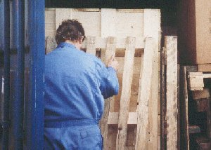
The person who packs and secures the cargo
is often the last person able to look inside a CTU before it is opened by the receiver at its destination.
Who will be exposed to risks and accidents ?
1-Drivers of road vehicles and other road users if the CTU is transported by road-railroad employees
and others, if the CTU is carried by rail
2-Crews of inland waterway vessels, if the CTU is carried on inland waterways.
3-Handling staff at inland terminals when the CTU is transferred from one means of transport to another.
4-Dock workers when the CTU is loaded and discharged.
6-Those who unpack the CTU be it the people at the ultimate destination or a CFS in another port.
7-All persons, such as the above and passengers in general may be at risk when something happens to a
poorly packed containers or vehicles carrying dangerous cargoes.
8-The environment and the population can also be a victim when accidents occur.
9- On top of all there could be important material damages as well.

Slide 35
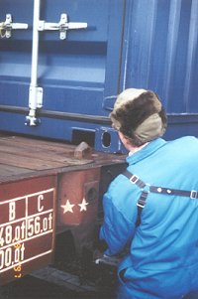
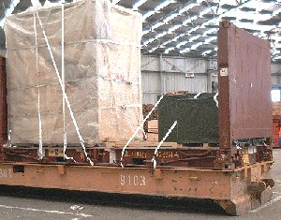
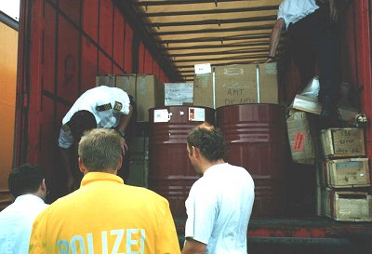
A few examples on HOW NOT TO DO IT
Inadequately secured cargo on a flat rack, loaded on a roll trailer
Improperly packed containers could reduce the safety of road vehicles, e.g. due to weights shifting within the container, and encourage vehicles to overturn. Containers transported on trailers constitute a particular hazard if they are poorly packed and the cargo is inadequately secured. Switchmen and other railroad employees are not responsible for checking that CTUs have been properly packed. Their inspection duties may extend to the proper securing of CTUs on freight cars, but not to the situation inside locked CTUs. If deficiencies are detected in open CTUs, a responsible employee is sure to intervene.
Water police inspecting a trailer to be carried by ferry

Slide 36
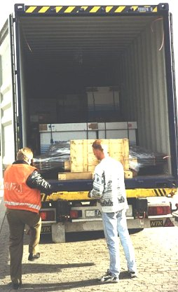
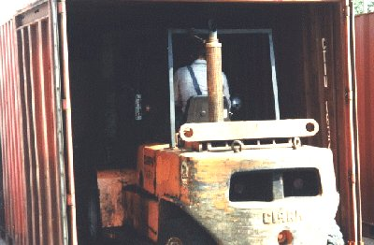
The problem is that cargo was not stowed and
Secured properly and the forklift could not grab it.
The total steel slabs were not put and secured on longitudinal wooden beams at the port of loading.
The container floor was damaged as well as one of the container walls a situation with shifting cargo that could have caused serous problems at sea.
Inadequately secured container load
Poorly packed, inadequately secured container loads may also put innocent third-parties at risk if shifting items of cargo smash through the container walls or cause a vehicle carrying the container to overturn.

Slide 37
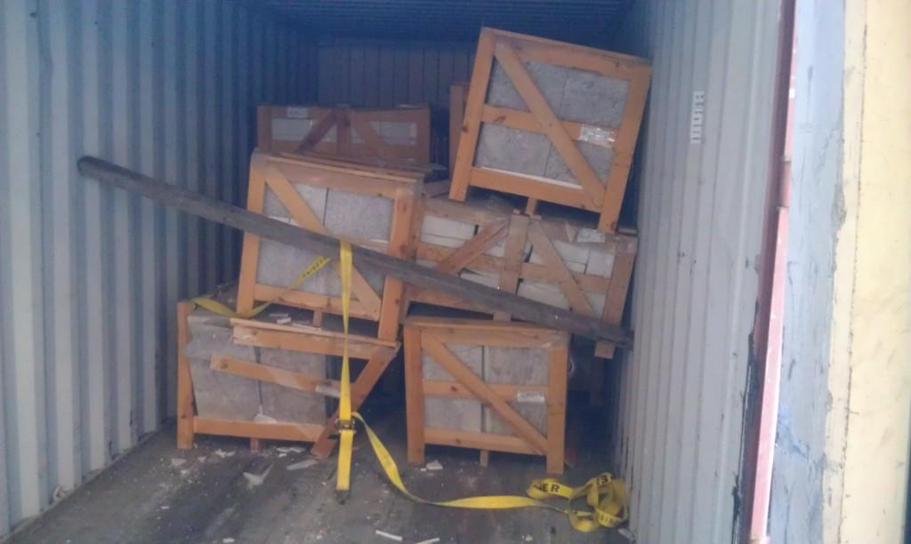
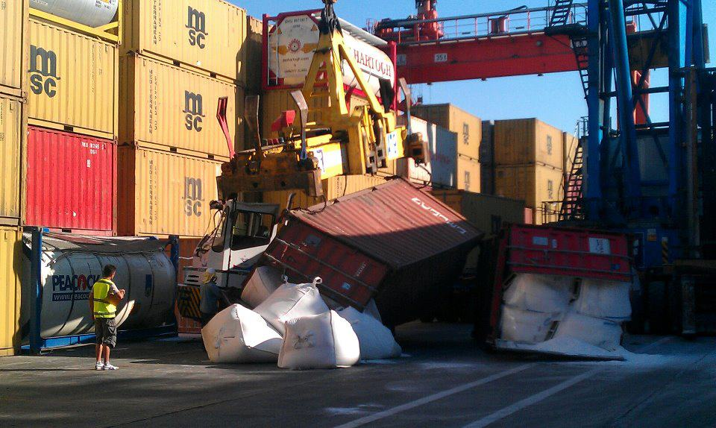
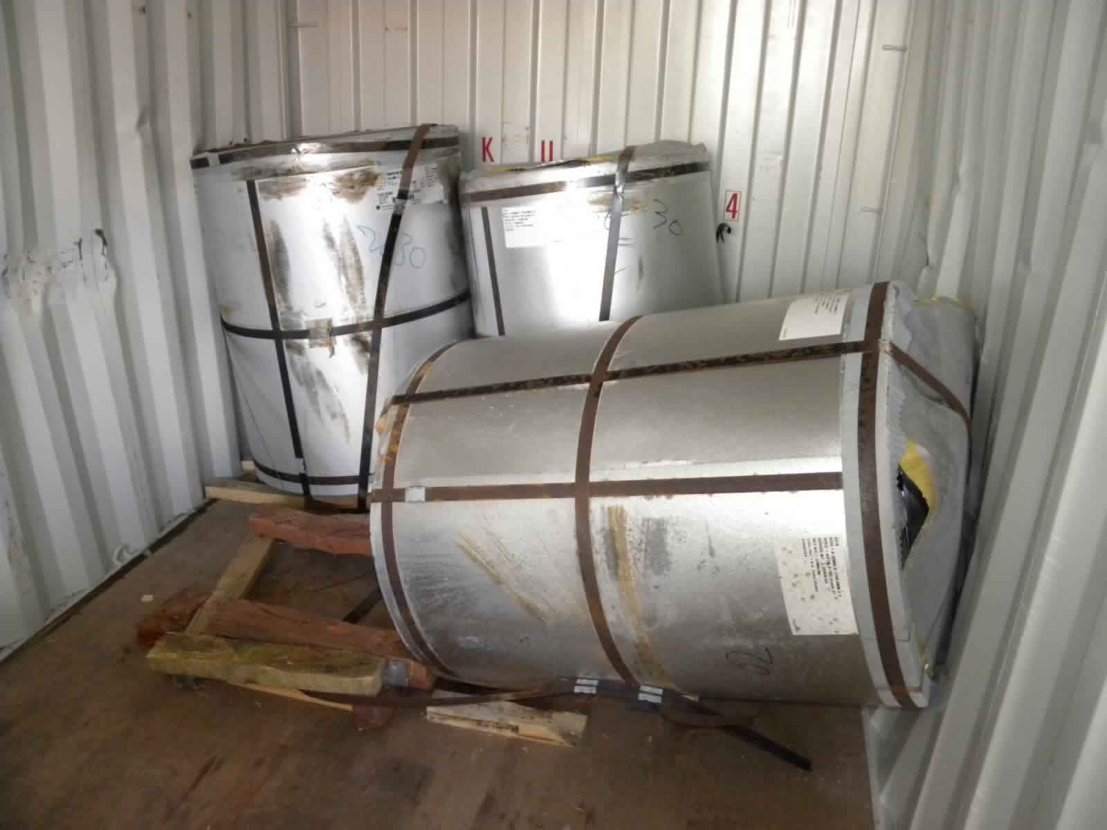
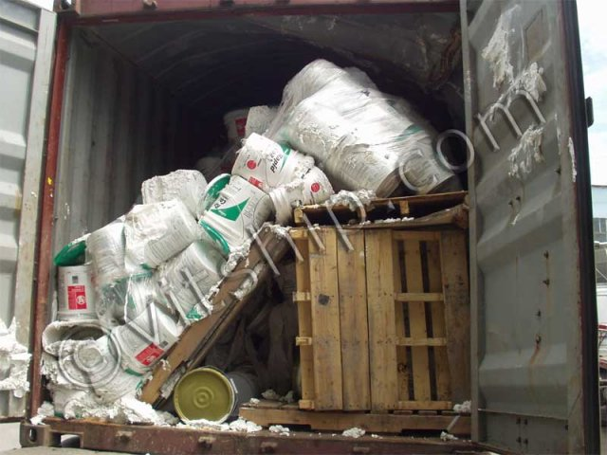
It's not the ship's management or crew who have fallen short. The main raison in this case were those who were responsible for packing some of the containers. Nothing has happened to properly packed and secured containers, while poorly packed containers with inadequately secured cargoes have been destroyed and cause collateral damage to other units. Spectacular incidents like this one are caused by a lack of focus and knowledge and training of those who have loaded the containers and the vessel. The consequences of carelessness are causing losses that rapidly add up to huge sums of money and claims from all the parties that have suffered , the owners of the cargo , the vessel owners , the eventual loss of life or bodily harm caused to the workers on board or at the destination port.

Slide 38
MAIN CAUSES OF DAMAGES-LOSS-ACCIDENTS DURING A CONTAINER VOYAGE /TRANSPORT ON LAND AND THE WATERWAYS 1-Human failure bad stuffing and securing of cargoes in the containers and on board of the vessels 2-False or wrong documentation and cargo details declarations 3-Bad handling on container terminals 4-No adequate lashing or securing related to the type of cargo 5-The general condition of the containers – validity of the ACEP or CSC plates 6-Mechanical stresses during cargo handling 7-Mechanical stresses in road /barge/rail transport 8-Mechanical stresses in inland waterway transport 9-Road or waterway incidents AT SEA 10-Chemical stresses 11-Shipping stresses 12-Static mechanical shipping stresses 13-Dynamic mechanical shipping stresses 14-Mechanical stresses in maritime transport 15-Climatic stresses 16-Biotic stresses 17-Fire on board of the vessel 18-Storms
POSSIBLE CONSEQUENCES OF BAD STOWAGE-STUFFING-SECURING-WRONG DOCUMENTATION
-Total loss of cargo due to ship losing containers
-Cargo damage due to improper cargo lashing of your goods inside the container
-Cargo damage due to improper cargo lashing and segregation of IMCO goods inside groupage boxes
-Cargo damage due to falling or moving containers on or against your container
HOW TO PREVENT MOVEMENT OF THE CARGO IN THE CONTAINER OR FLATRACK
-There is only one way to prevent movement of your cargo during sea transport
-Ensure that your cargo is secured properly
-Whether your cargo is transported by sea in a container, on a flat rack or on deck of a ship and
properly stuffing it and securing your cargo will prevent cargo damage.
-Use only containers in good condition with valid ACEP or CSC plates.

Slide 39
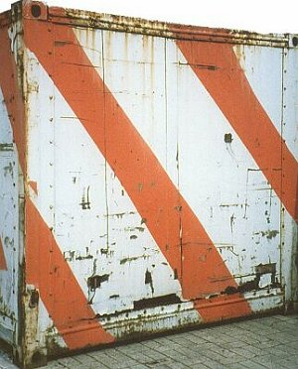
Damaged containers should not be used.
Insufficient knowledge and inadequate skills on the part of many of those involved in cargo shipping are the root causes of subsequent losses. Errors in the planning and execution of transport operations are for the most part due to human failure.

Slide 40
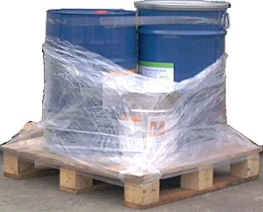
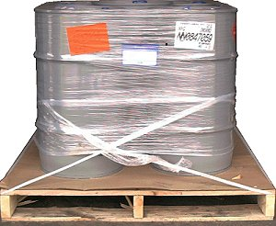
Inadequate training promotes damage. Poor understanding on the part of many of those in charge about the complex interrelationships involved in the provision of transportation services together with what is in most cases a very low level of training among the personnel involved with the physical handling of cargoes conspire to cost the world's economy billions every year. Insufficient knowledge and inadequate skills on the part of very many of those involved in cargo shipping are the root causes of subsequent losses. Basic errors are sometimes made as early as during design and production of the goods which are ultimately to be shipped. While this area will be addressed separately in the section "Packaging errors and deficiencies", some explanatory examples are given below.
Given the differing heights of the drums, this cargo unit
is even more difficult to pack into a container.
Non-regulation dangerous cargo unit

Slide 41
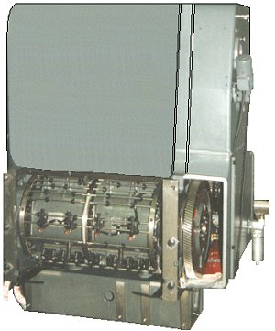
Designers not only have to take account of a machine's subsequent function, but also of the fact that it must first be transported to where it will be used and installed there without suffering damage. Every machine should have slinging and lashing points so that it can be handled and secured without problem.
Machine unpacked and without securing means not fit for shipping

Slide 42
Earth borer without securing means is not fit for shipping
This earth borer has no lashing points. In such cases, securing means are generally attached arbitrarily to components
which are not suitable for this purpose.
The absence of lashing points is particularly disadvantageous since this machine will be used at many different sites.
Every time the machine is moved, more effort will be required for securing, so increasing the shipping risk, which is
why attention must be paid to lashing points for easy transport securing from the design stage.

Slide 43
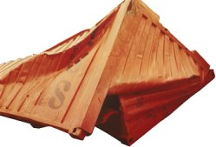
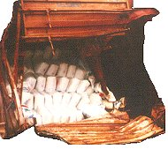
Topics to be included in a training program for the packing and securing of cargoes in cargo transport units (CTUs) 1 Consequences of badly packed and secured cargo 1.1 Injuries to persons and damage to the environment 1.2 Damage to ships and CTUs 1.3 Damage to cargo 1.4 Economic consequences Many may still remember the case of the French container ship "Sherbro" which lost a number of containers overboard in the English Channel. As a result, hundreds of thousands of plastic sachets containing the pesticide Apron plus entered the sea and were subsequently washed up on the coasts of France, the Netherlands and Germany. Injuries to persons and damage to the environment may be the result

Slide 44
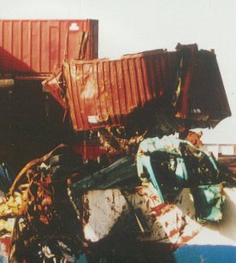
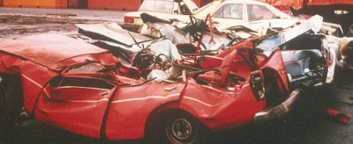
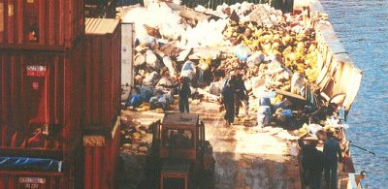
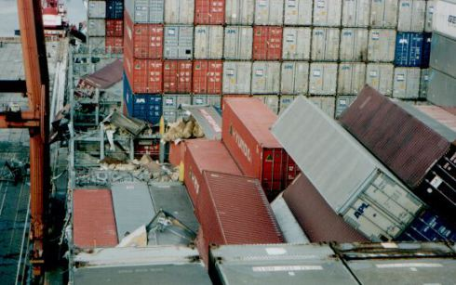
Damage to ship and CTU’s
Damage to cargo
Economic consequences

Slide 45
TRAINING IS KEY A training program would need to be adapted to the specific needs of all types of jobs/people It should be comprehensive and regularly recurring training sessions are necessary to ensure sufficient familiarity Port aid Antwerp can organize such sessions through their specialist organization. The basic courses would entail following sections: 1-Loss prevention through training The section "Scope" of the CTU packing guidelines contains an important statement and these Guidelines, which are not all-inclusive, are essential to the safe packing of CTUs by those responsible for the packing and securing of the cargo and by those whose task it is to train people to pack such units. Training is essential if safety standards are to be maintained. 2-Management responsibility Management should ensure that all personnel involved in the packing of cargo in CTUs or in the supervision thereof are adequately trained and appropriately qualified, commensurate with their responsibilities within their organization. 3-Safe packing All persons engaged in the transport or packing of cargo in CTUs should receive training on the safe packing of cargo in CTUs, commensurate with their responsibilities. 4-General awareness/familiarization Training on all aspects of the safe transport and packing of cargo, commensurate with their duties. The training should be designed to provide an appreciation of the consequences of badly packed and secured cargo in CTUs, the legal requirements, the magnitude of forces which may act on cargo during road, rail and sea transport, as well as basic principles of packing and securing of cargoes in CTUs.

Slide 46
5-Verification: The adequacy of the knowledge of any person to be employed in work involving the packing of cargo in CTUs should be verified or appropriate training provided. This should be supplemented by periodic training, as deemed appropriate by the regulatory authority. 6-Recommended course syllabus - overview: The function-specific training should be commensurate with the duties required to be performed by an individual in the packing and securing of cargo in CTUs. Topics for consideration, to be included in the training as appropriate. 7-Liabilities Different parties involved in cargo transport Legal responsibility Goodwill responsibility Quality assurance 8-Forces acting on the cargo during transport Road transport Rail transport Sea transport 9-Basic principles for cargo packing and securing Prevention from sliding Prevention from tipping Influence of friction Basic principles for cargo securing Dimensions of securing arrangements for combined transportation

Slide 47
10-Forces acting on the cargo during transport such as Road transport Rail transport ea transport 11-Basic principles for cargo packing and securing Prevention from sliding Prevention from tipping Influence of friction Basic principles for cargo securing Dimensions of securing arrangements for combined transportation 12-types of ctu’s Containers Flats Swap-body Road vehicles Rail cars/wagons Forks Cranes Straddle carriers Overhead cranes Other Terminal equipment

Slide 48
13-Cargo care consciousness and cargo planning Choice of transport means Choice of CTU type Check of CTU prior to packing Cargo distribution in CTUs Requirements from the receiver of cargo regarding cargo packing Condensation risks in CTUs Symbols for cargo handling 14-Different methods for cargo packing and securing Lashing Blocking and bracing Increasing friction 15-Equipment for securing and protection of cargo Fixed equipment on CTUs Reusable cargo securing equipment One-way equipment Inspection and rejection of securing equipment 16-Packing and securing of unitized cargo (bulk) Cases (boxes) Palletized cargoes Bales and bundles Bags on pallets Flexible IBCs Slabs and panels Barrels Pipes Cartons

Slide 49
17-Packing and securing of non-unitized cargo (break-bulk) Different types of packaged cargoes loaded together Packing of heavy and light cargoes together Packing of rigid and non-rigid cargoes together Packing of long and short cargoes together Packing of high and low cargoes together Packing of liquid and dry cargoes together 18-Packing and securing of paper products General guidelines for the packing and securing of paper products Vertical rolls Horizontal rolls Sheet paper on pallets 19-Packing and securing of cargo requiring special techniques Steel coils Cable drums (reels) Wire coils Steel slabs Steel plates (sheet) Big pipes Stone blocks Machines 20-Packing and securing of dangerous cargoes Regulations for the transport of dangerous cargoes Definitions Packing regulations Packing, separation and securing Labeling and placarding Information transfer when transporting dangerous cargoes Liabilities

Slide 50
Part 2: Container inspection –testing-Inspection-maintenance
1-Introduction
The IICL has developed a standard world wide repair system whereby all parties that
operate or leases containers adhere to.
These guidelines are accepted all over the world by ship owners,container lines,
rail and truck operators that all work according the same standards and methods.
One can say that globally the IICL standard is omnipresent.
It was necessary to create a method whereby safety-container types-verification methods
as well as verification and quality maintenance was guaranteed.
At the same time it also created a system whereby the quality of the repairs and maintenance
were maintained at a higher standard and had a direct influence on the life time of a
container and offered a higher security, certainty and quality for the user/shipper who were
an important category of stakeholders in container shipping.
In the meanwhile one can hardly escape the rules and regulations of the IICL since
practically all of the shipping companies are only allowing containers on their vessels that
have a valid CSC or ACEP plate.
By doing this and they avoid accidents on board of their vessels at sea or at the terminals
they operate.
Also the shippers have a guarantee that their cargo is shipped in a container that is
technically in order and does not get damaged or lost during the voyage.

Slide 51
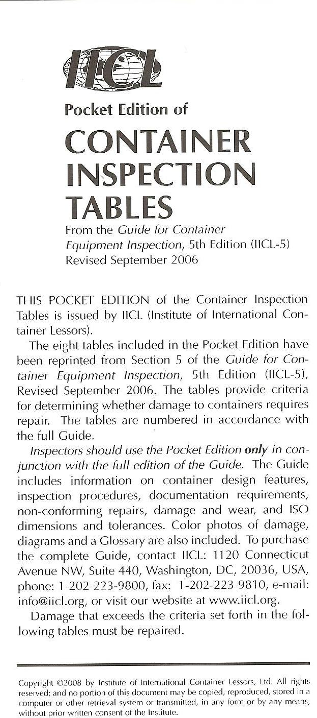
Overview of IICL Standard inspection tables

Slide 52
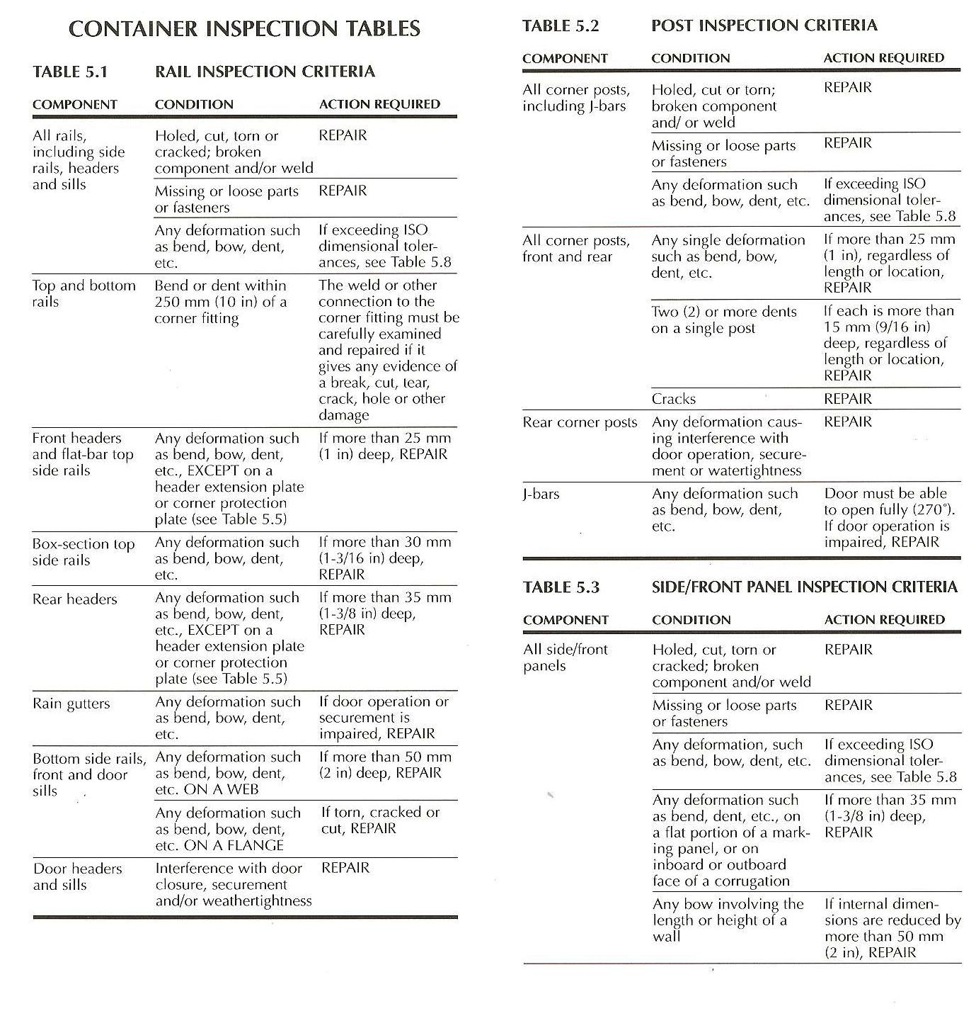

Slide 53
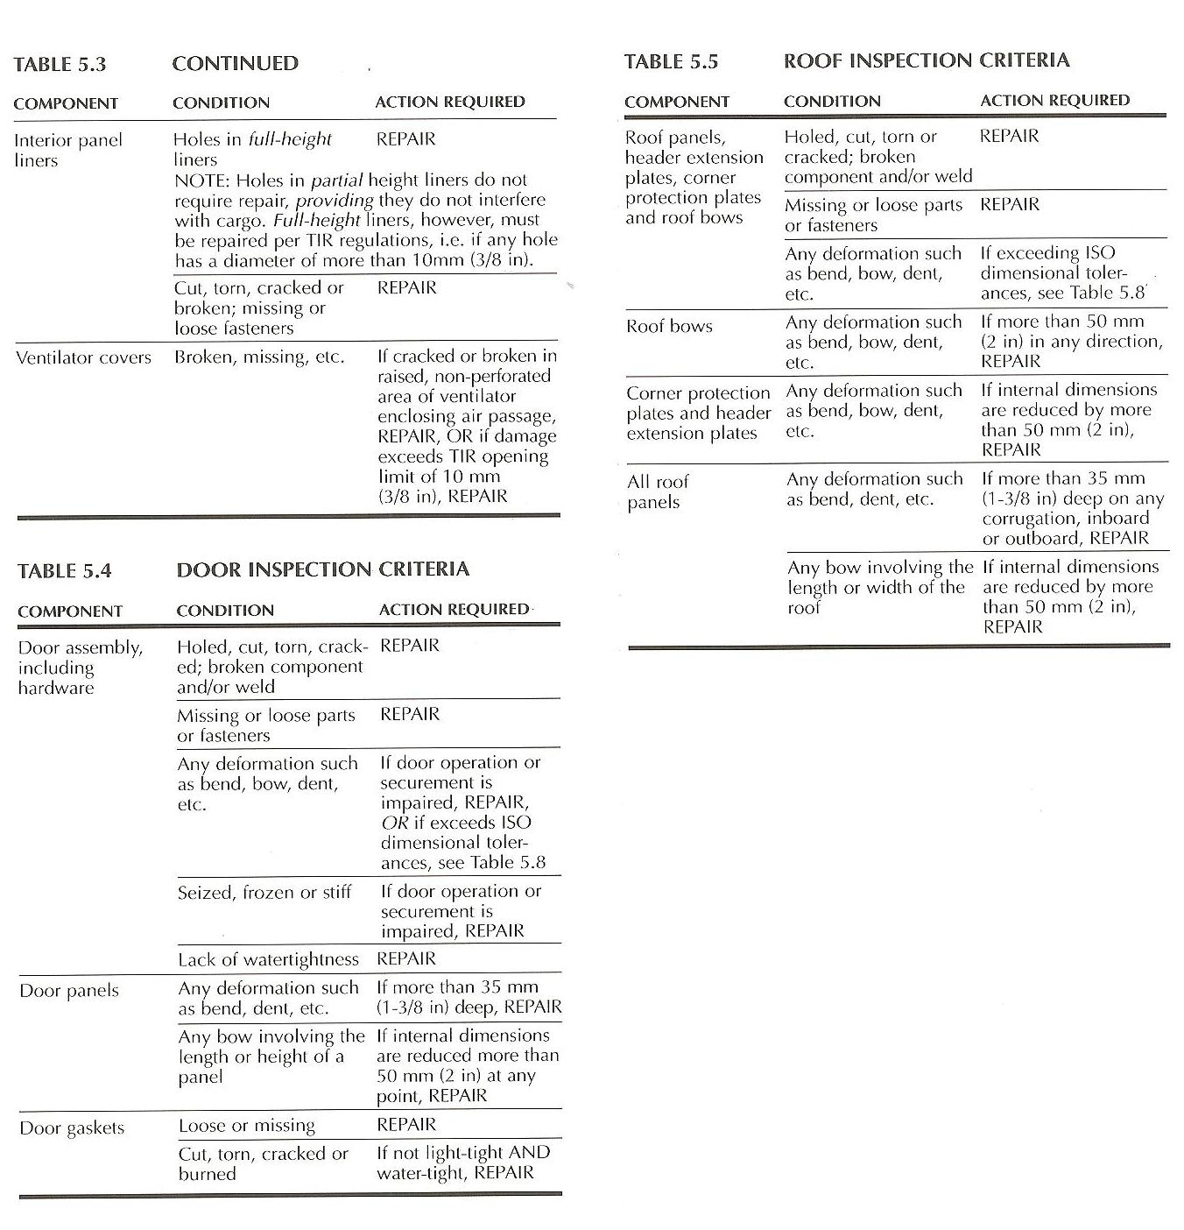

Slide 54
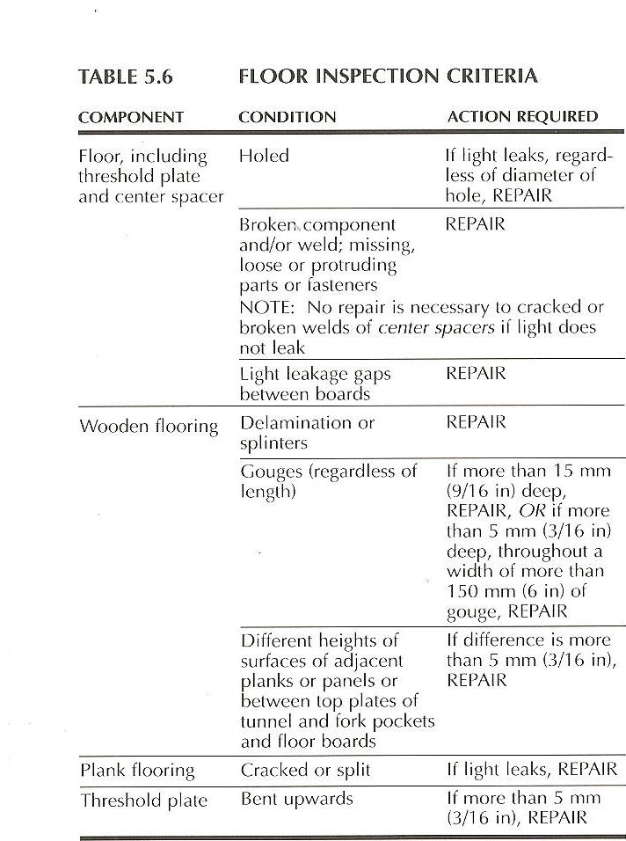

Slide 55
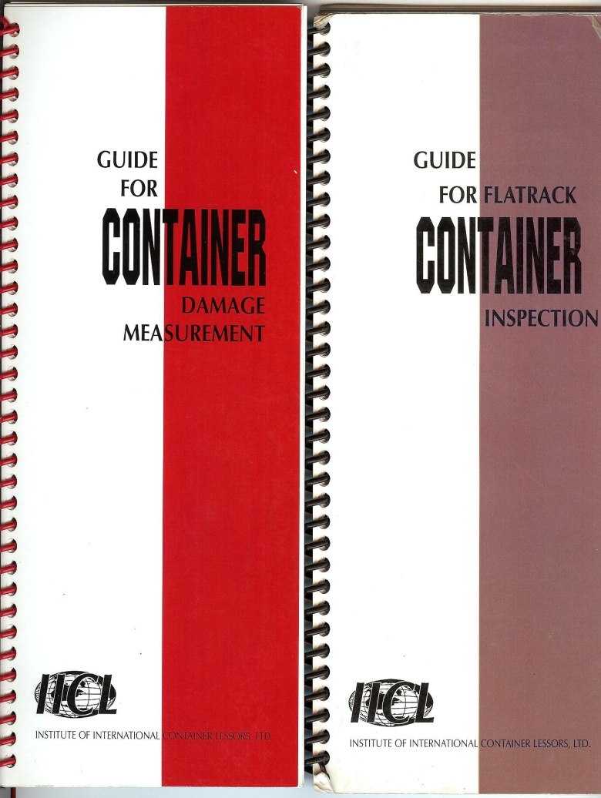
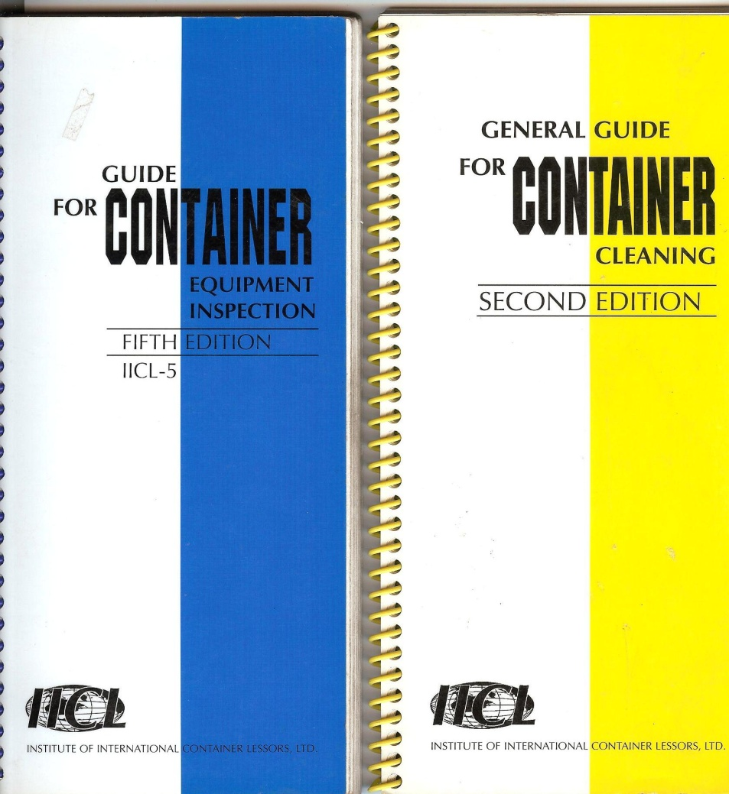
IICL 5 Guides for inspection & repairs of containers

Slide 56
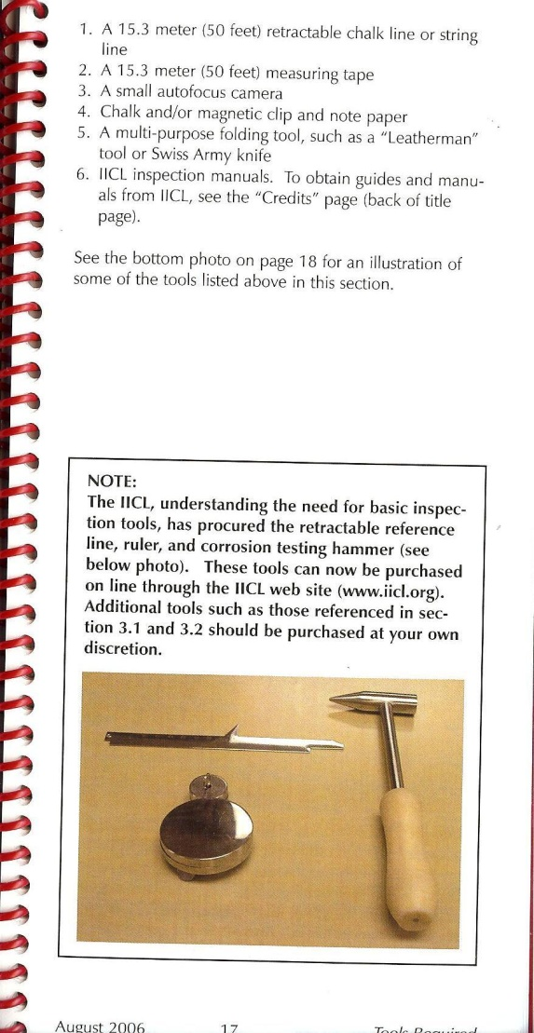
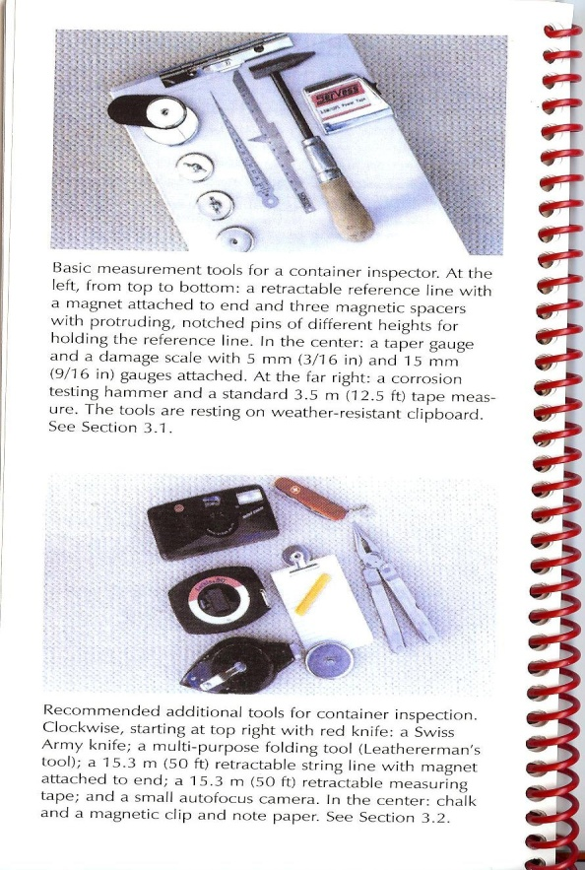
IICL 5 Methods of Container Inspection according to standards
Damage Measurement Tools -Damage measurement requires a certain number of tools.
-Basic measurement tools consist of the following:
-Retractable reference line of at least 2.9 meters (9.5 feet) with magnet attached at the end. Damage scale.
-This generally consists of a ruler of at least 150 mm (6 inches) long.
-These tools are an essential component for an inspector to carry with him during the inspection process.

Slide 57
Damage measurement of Roof panel damage - to repair or not

Slide 58
Damage measurement of inside side wall – to repair or not

Slide 59
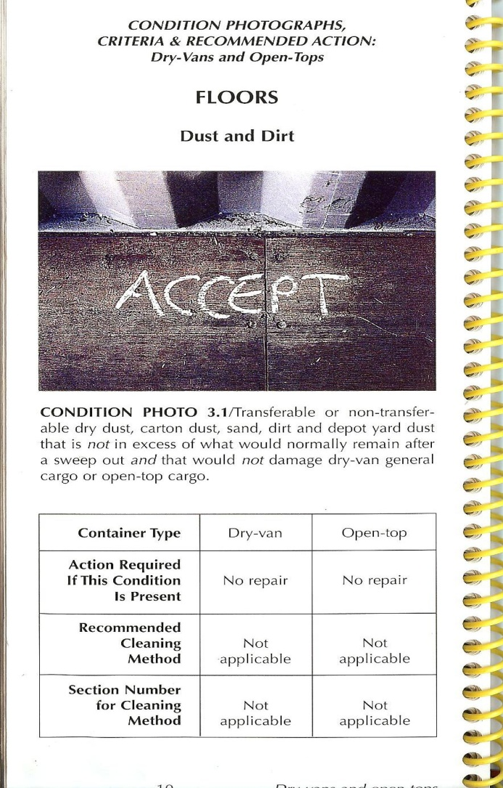
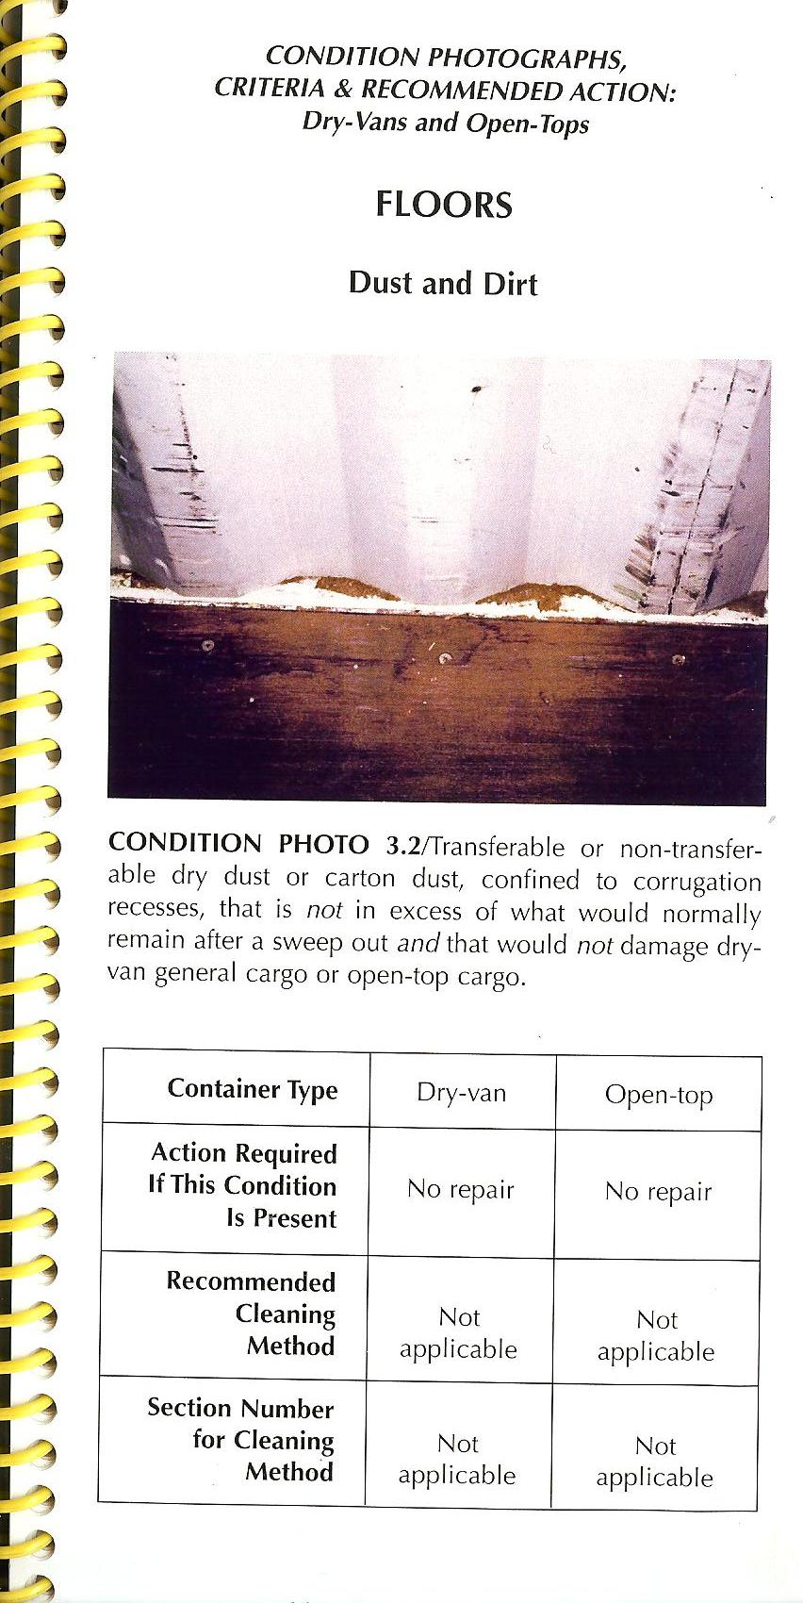
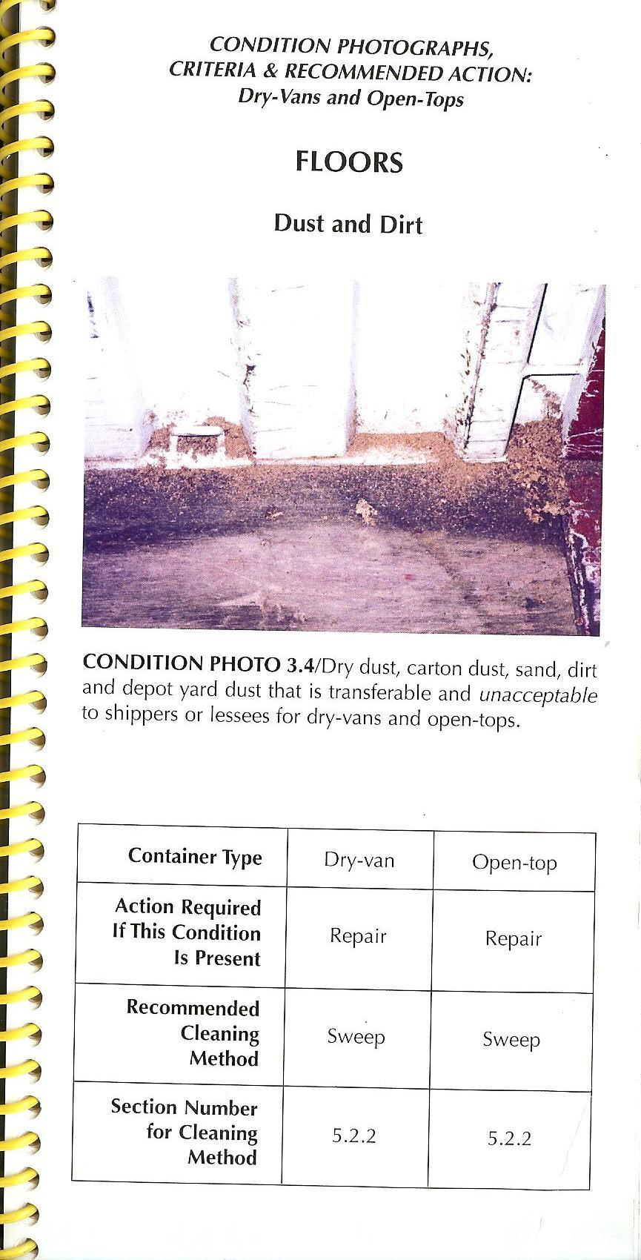

Slide 60
IICL Technical Guides & Manual
Since 1971, IICL has published over 50.000 copies of 20 publications covering container inspection, repair, cleaning and refurbishment, chassis inspection and maintenance, and other topics.
IICL manuals have been distributed to over 3.000 companies in over 65 countries across the globe.
Publications on Containers
Guide for Container Equipment Inspection, 5th edition ("IICL-5") (September 2006) Provides criteria for determining if damage to containers requires repair. Published jointly with the International Chamber of Shipping (ICS), the criteria apply both for on/off-hire and in-service inspections. The Guide was developed by a Joint Working Group of representatives from shipping lines and leasing companies worldwide. Based in part on the container testing project initiated in 1984 with HLA Engineers, Inc. in cooperation with the University of Texas at Arlington. Using finite element analysis, backed by physical tests, HLA engineers and IICL technical experts tested the capacity of a container to withstand damage. A Pocket Edition of the Container Inspection Tables supplements the main volume.
Technical Bulletin G5. Amendment to the Guide for Container Equipment Inspection, 5th Edition ("IICL-5") (SEPTEMBER 2000) Included as an amendment in all copies of the Guide for Container Equipment Inspection, Fifth edition, sold since October 1, 2000. The bulletin cancels IICL-5 criteria relating to cleanliness, as they have been superseded by the second edition of the General Guide for Container Cleaning (see publication below).
Repair Manual for Steel Freight Containers, 5th edition (March 2006) Contains recommendations for repair of steel containers, many presented by means of color photographs. Covers general repair principles and procedures, repair of individual container components, safety precautions, materials and tools, non-conforming and improper repairs, terminology and interpretation of ISO dimensions.

Slide 61
Surface Preparation and Painting: An Addendum to the Repair Manual for Steel Freight Containers (Fifth Edition) (JUNE 2000) The bulletin includes information on surface preparation and coating.
General Guide for Container Cleaning, 2nd edition (May 2000) This Guide uses color photographs to illustrate different types of container conditions in dry van, open top and refrigerated containers that may or may not require cleaning. For each condition, the Guide recommends the action to be taken, if any, and the cleaning procedure to use, if the container requires cleaning. Areas covered include general principles for determining when to clean, possible harmful contamination and recommended action, and recommended cleaning methods for all types of conditions.
Guide for Container Damage Measurement (August 2006) Provides methods of measuring damage to containers, including unusual cases. Explains how to calculate if damage exceeds ISO and IICL tolerances and describes tools required for container damage measurement.
Guide for Open Top Container Equipment Inspection (November 2005) Provides careful and structured procedures for the inspection of open top containers. The guide was developed to address not only the inspection of components but also the cleaning decisions specific to these containers. The manual also provides several diagrams detailing the configuration of open top container components, damage conditions, and cleanliness criteria and recommended actions.
Guide for Flat rack Container Inspection (August 2003) Describes the best practices for inspecting and repairing flat rack containers. The guide includes specific criteria for determining if a flat rack requires repair and also recommends repair procedures for certain components. The manual also describes flat rack construction, usage and lifting requirements, and provides several diagrams of flat rack types, individual components and correct/incorrect lifting methods.

Slide 62
Guide for Flat rack Container Repair (June 2008) The IICL has developed a Flat rack Repair manual to offer a comprehensive instruction for repairs to flat racks in service today. The manual is unique in that in includes various photo essays for the complex repairs of critical structural components unique to this equipment type.
Supplement on Inspection and Repair: Gray Areas, 2nd edition (2003) Clarifies "gray areas" in container inspection and repair that have remained open to interpretation and thus the source of disputes. Such areas include conditions where it is unclear whether repair is required or not; wear and tear vs. damage; improper repairs; and others. Color photos illustrate conditions such as improper panel straightening, floor delaminating and rolling shear failure.
CSC pamphlet (Convention for Safe Containers, (6th edition) (2002) Explains the Convention's provisions for the periodic inspection of containers, ACEP inspections, original approval and administration, including enforcement.
Pocket Edition of Container Inspection Tables, (2005) Provides criteria for determining whether damage to containers requires repair. The tables are numbered in accordance with the full guide.

Slide 63
Publications on Refrigerated Containers
General Guide for Refrigerated Container Inspection and Repair, 3rd Edition (June 2005) Contains inspection criteria and repair recommendations for reefer containers.
Publications on Chassis
Guide for Container Chassis Inspection & Maintenance, 4th edition (May 2006) Provides instruction on how to inspect chassis and criteria for determining if damage to chassis requires repair. Includes latest USDOT regulations, including rules on conspicuity, automatic brake systems and automatic slack adjustors. Illustrated by 59 new photographs of typical damage and numerous diagrams. Includes information on chassis types, design, damage vs. wear and terminology. Sets forth components to be inspected daily, monthly and annually with inspection criteria for each component, including FHWA requirements and maintenance procedures when required.
Photocopies of inspection forms supplement this manual.
Guide for Floorboard Quality Assurance Program (IICL Technical Bulletin 006) This guide provides a procedure and guidance for the quality assurance auditing of plywood mills that supply container flooring. The procedure focuses on the steps in the plywood manufacturing process that are most critical to the production of high quality container flooring. Although there are variations in the production process among plywood mills, the critical manufacturing process steps address in this procedure are common to all plywood manufacturing and the control of these processes is the key to producing a quality product.
Damage Measurement Tools Damage measurement requires a certain number of tools.
The inspector should keep these tools on hand at all times when inspecting a container.
Basic measurement tools consist of the following:
Retractable reference line of at least 2.9 meters (9.5 feet) with magnet attached at the end. Damage scale.
This generally consists of a ruler of at least 150 mm (6 inches) long.
Corrosion testing hammer (having a tapered end with a rounded point)
These tools are an essential component for an inspector to carry with him during the
inspection process.
63

Slide 64
CSC
Convention for Safe Containers
Source: International Convention for Safe Containers, 1972 (CSC) 2012 edition
International Maritime Organization publication – sales number IMO-IB282E

Slide 65
The objective of CSC
1-To ensure a high level of safety for human life by formalizing common international safety rules, technical standards and requirements.
2-To standardize the structural design of the
containers and the ongoing inspection and their
maintenance world wide.

Slide 66
CSC an international agreement made in 1972
Convention for Safe Containers.
The countries adopting CSC are known as Contracting Parties, for example, the EU countries are contracting parties.
CSC is administered by the governments of the Contracting Parties or by organizations designated by the governments for example the following classification societies:
-ABS (American Bureau of Shipping) in the USA,
-CCS (China Classification Society) in China
-BV ( Bureau Veritas) in France
-Germanischer Lloyd
Approvals under the authority of a Contracting Party are accepted by all the other contracting parties.
As a result, containers can operate worldwide under a single set of safety regulations.

Slide 67
CSC sets international standards in two areas
1-The design of the containers
Design type approval to ensure that new containers are designed and built
to meet ISO (International Standardization Organization) dimensional and
strength requirements.
2-The safety inspections
Safety inspections to ensure that containers are maintained in safe condition during their operating lives.

Slide 68
Design type approval
The classification society
•reviews the container design
•load tests prototype containers to ISO requirements
•load tests samples from production 1 out of 100 units produced
•checks dimensions to ISO standards
•inspects production
Designs meeting all CSC and ISO requirements are assigned a CSC number
which appears on the safety approval plate (CSC plate) of every container
built to that design.

Slide 69
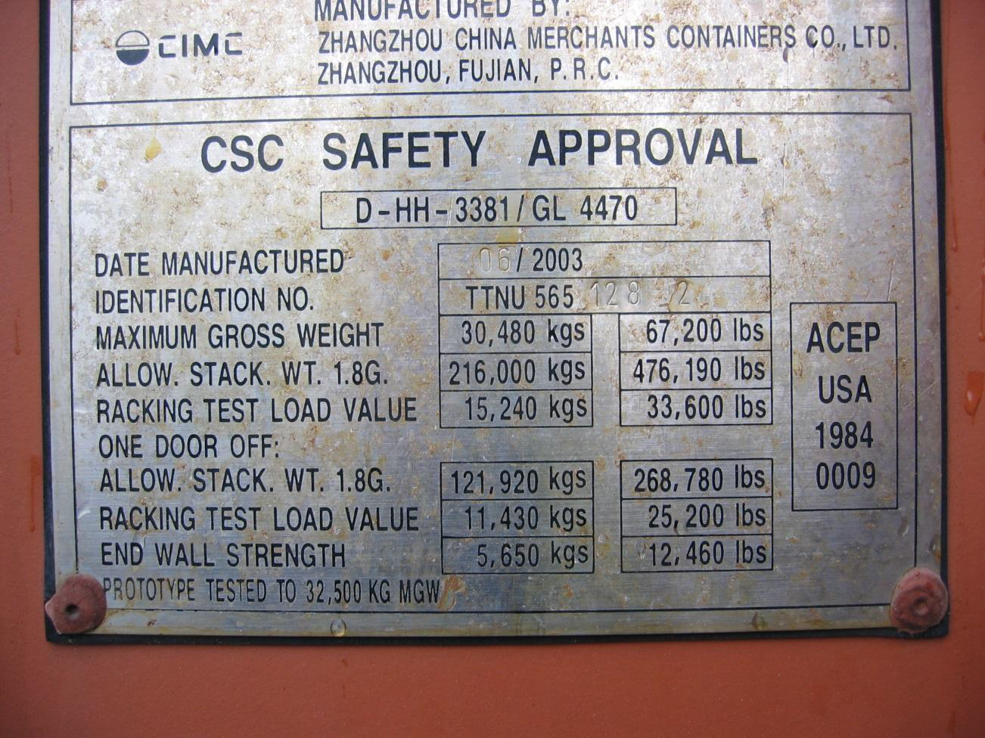
Safety approval plate
Showing the classification society design approval
CSC Approval number

Slide 70
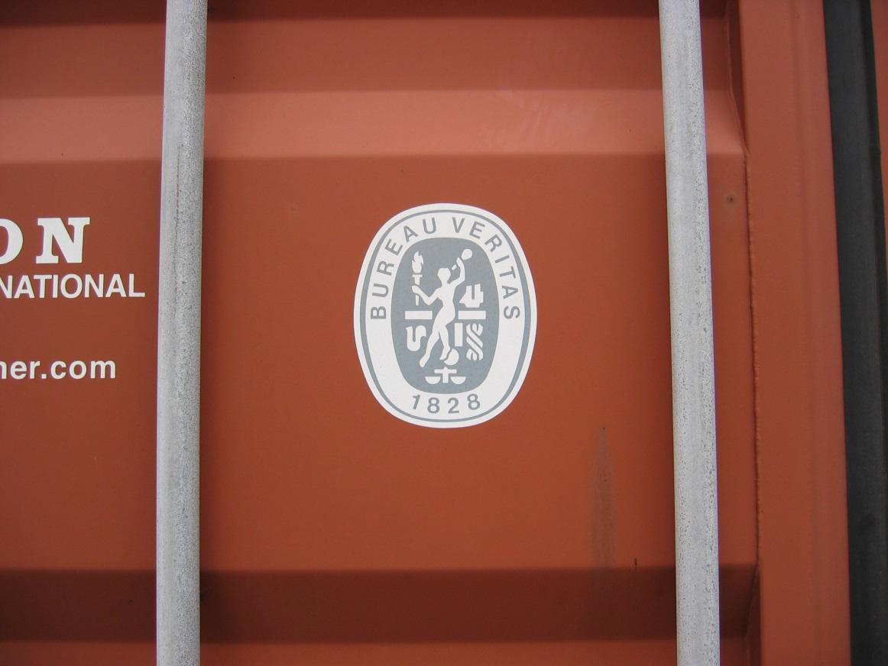
The classification society’s decal
Classification Society decal
is placed on the door of the container

Slide 71
The CSC Examination requirements
The first safety examination no later than 5 years from the date of production.
Re-examinations are to be made at least every thirty months thereafter.
The objective of the Examinations is to determine whether the container has structural damages that can place a persons/cargo/vessels/road & rail in danger.

Slide 72
Safety examinations is accomplished in one of two ways
1-Periodic Examination Scheme (PES)
This is the original approach that is currently generally used by small
operators and requires the display of the “next examination date” or “NED”
on the CSC plate.
2-Approved Continuous Examination Program (ACEP)
The system currently used by most container owners and operators.
Both procedures are intended to ensure that containers are maintained to the required
level of safety.

Slide 73
The Periodic Examination Scheme
A decal is affixed to the safety approval plate that lists the month
and year for the next scheduled safety inspection.
In some cases the first examination date is engraved on the CSC plate.
If the month and year have passed then the prior inspection has expired
and the container has to be re-inspected

Slide 74
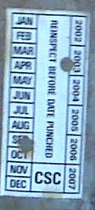
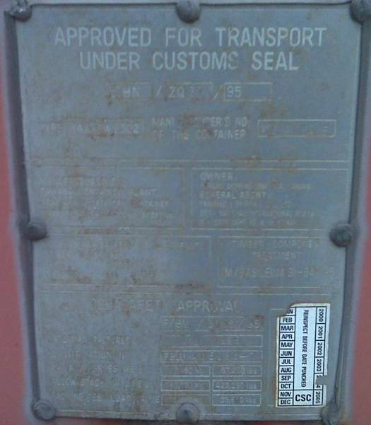
Safety approval plate with periodic examination
Decal showing date of next required safety inspection
Periodic examination decal (month and year of expiration)
Decal
Engraved
Periodic examination decal (month and year of expiration)

Slide 75
The Approved Continuous Examination Program (ACEP)
ACEP is based on the premise that the safety examinations taking place in the normal operation of the container meet the CSC’s five year and the thirty month examination requirements.
Normal operating inspections include off-hire and on-hire inspections for leased containers and in-service inspections for shipping line operating containers.
Unlike the Periodic Examination Scheme, the Approved Continuous Examination programs
do not have expiration dates.
ACEP is assigned to the owner/operator of the container by the Classification organizations
BV Bureau Veritas
GL Germanischer Lloyd
CCS (China Classification Society)
and others

Slide 76
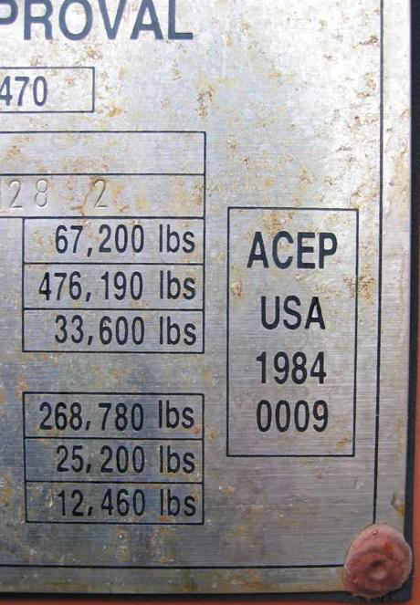
Safety approval plate with Approved Continuous Examination Program (ACEP)
Approved Continuous Examination Program - ACEP
Country code where the approval for the ACEP was granted
Year when the approval for the ACEP was granted (this is not an expiration date)
ACEP registration number ACEP
Approved Continuous Examination
Program - ACEP
Decal ACEP
Country code where the approval for the ACEP was granted
Year when the approval for the ACEP was granted
(this is not an expiration date)
ACEP Registration number
that is granted

Slide 77
Safety Examination Standards
The standards that apply for safety examinations are those agreed upon between the administration of the contracting party and the container owner/operator at the time of the assignment of the ACEP approval.
Standards will vary depending on location, but usually as a minimum, large deflections, cracks and tears, missing parts involving structurally significant components that could present safety risks to personnel are not allowed.
Party Responsible for Safety Examinations
Although the CSC regulations assign responsibility for examinations to the container owner practical considerations, commercial practice, and contractual agreements transfer the responsibility to the party in possession of the container (e.g. in the case of equipment being interchanged between owners and users.)

Slide 78
Consolidated Data Plate
In addition to the CSC information, the consolidated data plate contains the following information:
TIR Approval
Confirmation that the container meets the requirements for international transport
under customs seal.
The container is designed such that goods cannot be removed from or introduced into
the box without breaking the customs seal or without leaving obvious traces of
tampering.
Owner’s Identification
Owner’s serial number, name and address.
Floor Treatment - TCT
Confirmation that the wood floor is chemically treated to prevent infestation per
Australian regulations.
Manufacturer’s Identification- Name and address.

Slide 79
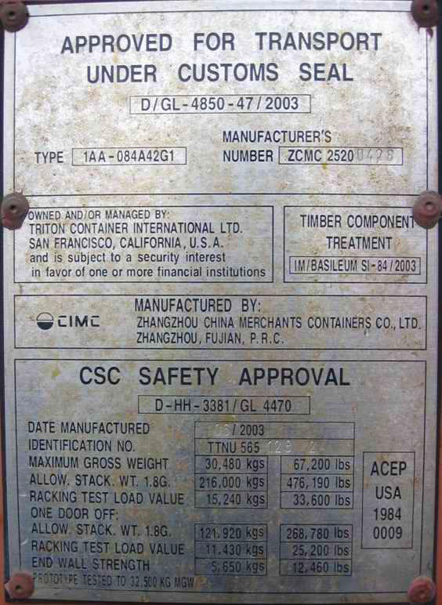
Consolidated Data Plate example
TIR Approval
Owner’s ID
TCT – Floor Treatment
Manufacturer’s ID
CSC Approval

Slide 80
ACEP / PES Identification Requirements
Who usually does what ?
Lessor Lessee Plate marking
ACEP ACEP Not specified by IMO
ACEP PES Lessee PES decal
PES ACEP Lessee ACEP decal

Slide 81
CSC Plate Identification Number
Effective July 2014 the Identification number on the CSC plate will be the manufactures ID number and no longer the owners’ identification number.
The owners ID number will appear in the owners’ identification section of the consolidated data plate.
The Manufacturers Identification number shall be marked on at least two of the following locations:
-the top or rear face of the left rear corner fitting
-the top or front face of the left front corner fitting

Slide 82
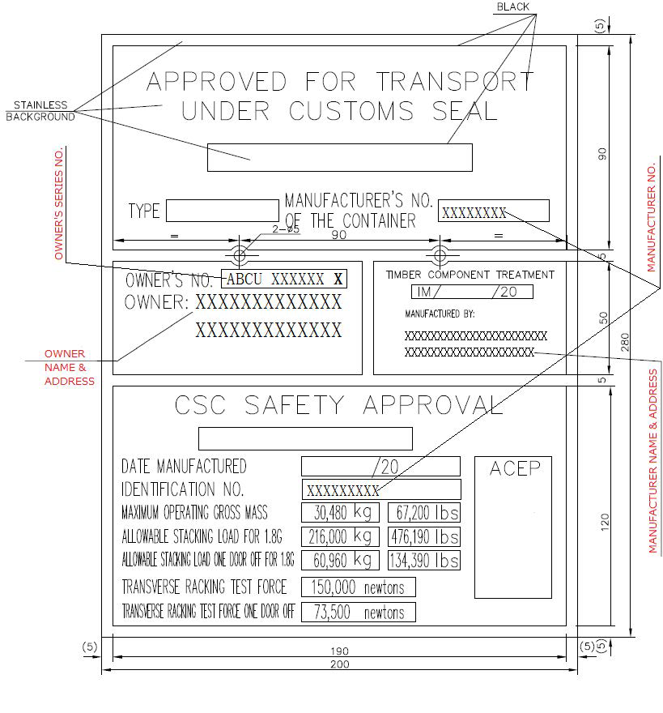
The Revised CSC Plate as of July 2014 for containers built after that date.
All boxes built before that date will still have the old version of the plate

Slide 83
BIC CODE
THE INTERNATIONAL IDENTIFICATION CODES
OF CONTAINER OWNERS BASED ON THE
ISO 6346
1-Identification system and its associated marks
2-Size and type codes and their associated marks
3-Operational marks
4-Physical display of marks
5-Deterùmination of the check digit
6-Symbol to denote air/surface container
7-Sign warning of overhead electrical danger
8-Size code
9-Type code designation
10-Height marks for containers higher than 2.6 m (8ft.6in)
11-Registration with the International container bureau (BIC)

Slide 84
THE INTERNATIONAL IDENTIFICATION CODES OF CONTAINER OWNERS
CALLED "BIC Codes" or "ISO Alpha-codes"
The international identification code of containers proposed by the Bureau International des Containers (BIC) since 1969 has been standardized by the International Organization for Standardization (ISO) in 1972. It forms an essential part of the ISO 6346 standard : « Freight Containers - Coding, Identification and Marking ». (This standard describes otherwise some technical complementary markings such as size and type code, country code and various operational marks).
Only ISO Alpha-codes for identification of container owners registered with the BIC may be used as unique identity marking of containers in all international transport and customs declaration documents It comprises : • an owner/operator code of 3 letters, • a fourth letter used as equipment identifier (1) • a serial number of 6 Arabic numerals (2) • a seventh digit (check digit) providing a means of validating the recording and/or transmission accuracy
of the data. Example (theoretical- for a container): BICU 123456 5 It guarantees
that the identification of the container is unique. It permits : • the identification of the owner or principal operator • the identification of the unit by its owner or operator as reference number for its data base
(dimensions, type, year of putting into operation, date of control, of maintenance, etc..). It facilitates • the international circulation and temporary admission for customs purpose, • the control of containers, manually or automatically by computerized and/or remote control systems at any stage of the transportation chain and especially in intermodal transport. It is accepted by : • the World Customs Organization and a number of Customs Administrations of which it facilitates the task in relation with the Customs Convention on Containers, the TIR convention, etc.., (WCO) • the International Road Transport Union (IRU) • the International Union of Railways (UIC), • the International Chamber of Shipping (ICS), • the International Air Transport Association (IATA), • the International Federation of International Removers (FIDI),

Slide 87
CONTAINER EQUIPMENT TYPES
1-THE CONTAINER EQUIPMENT TYPES – LISTED IN ISO NORMS 6346
Box Code GP
General purpose containers without ventilation 20-30-40-45 ft – 8” - 8’6” – 9’6” height
Box Code VH
General purpose containers with ventilation 20-30-40-45 ft – 8’ - 8’6” – 9’6” height
Box code BU
Dry bulk container non-pressurized 20-30-ft 8’6” height
Box code BK
Dry bulk container pressurized 20-30ft 8’6” height
Box code SN
Live stock carrier-automobile-live fish box 20-40 ft height 8’
Box code HR Refrigerated and HI insulated
Thermal container 20ft-40ft-45ft- height 8’ - 8’6”
Box code UT
Open top container removable top 20ft-40ft - height 8’6”
Box code PL
Platform container with super structure 20ft-30ft-40ft – height 8’ – 8’6”
with end panels and without end panels
Box type TN
Tank box for liquids –dangerous liquids-gasses – heights 8’-8’6”
General info:
8’6”ft = 2.60 meters
9’6”ft = 2.90 meters

Slide 88
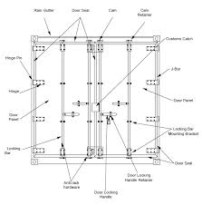
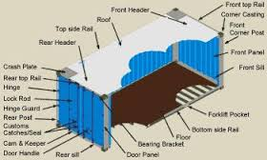
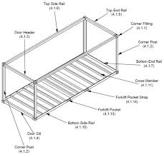
STANDARD CONTAINER PARTS

Slide 89
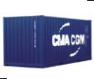
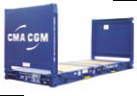
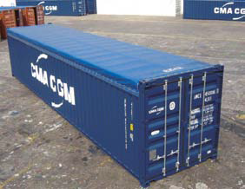
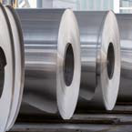
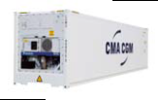
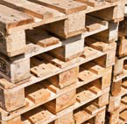
STANDARD CONTAINER TYPES AND USAGE
General purpose Container 20
Collapsible flat 20 and 40 foot
Open Top 20 and 40 foot with tarpaulin roof
General purpose Container 40 foot
Reefer container 20 & 40 foot
Tank container for liquid foodstuff & chemicals 20 foot

Slide 90
In addition to the standard equipment like dry boxes-reefers-flats-open tops-tanks there are
also specialized containers adapted to specific goods like :
Autotainers
For the transportation of vehicles and
GOH
containers’ for the transport of garments on hangers.
All containers are suitable for multi-modal transport and can be seamlessly transferred from
ship to rail-barge and onto truck.
All containers meet ISO standards 668, 1496/1 and 6346
C.S.C. criteria (Convention for Safe Containers)
T.I.R. criteria
(Customs Convention for the Road Transport of Goods) and U.I.C. criteria (International
Union of Railway).
Containers are monitored and maintained by their owners worldwide by their team of experts
who ensure the units meet these standards and maintain a constant level of quality.
If the cargo is oversized and does not fit into a standard container the shipping companies
will offer solutions to ship it safely according to “best practices commodity guidelines”
The box fleets are monitored by a stringent container control system that allows to manage
the fleet world wide.

Slide 91
Acceptance and rejection of containers
1-There are number of basic rules that one should apply all the time and in any situation to avoid
being the party that has found negligent whilst handling-stripping-stuffing containers.
a-A container terminal should always make sure that all incoming and outgoing
full and empty containers are checked on the certification ACEP-CSC and damages.
In principle the containers must be in a condition that these can be handled safely
and that there is no structural damage to the box.
b-When there would be a situation whereby the goods inside the box would or could
be damaged and cause accidents during transport or handling adequate measures
should be taken by the terminal to block the container and eventually transfer the
goods into another container via the CFS.
Specifically the IMCO goods can be a very big risk is such goods are stuffed or
arrive at the terminal in a damaged condition be it structural or any other damages
that could have a bearing on the safety on the terminal and on board of the vessel.
c-The consequences of an incident whereby , through negligence, a damaged box
would cause an accident of any kind , pollution or human suffering , the liability
of the terminal operator could be very important.
d-Therefore it should be standard practice to maintain a checking procedure IN/OUT
of the terminal and stop-return-or put the box aside somewhere in a safe place
until such time a decision can be made by the various parties involved on how
such a situation would be resolved.
e-Not only structural or severe damage to a box are playing but also the validity
of the CSC or ACEP plates since these give an indication when the container has
or has not been inspected and re-approved for usage.
f-Specifically, most of the problems of such kind are with Shippers Owned boxes
that have been purchased but never passed a CSC or ACEP inspection.

Slide 92
2-It is evident that the terminals are the parties that have a definite interest in a rigid
application of the International Standard regulations and to apply those within their
multiple operations.
a-It reduces their liabilities and risks enormously towards their clients and ship
owners the subcontractors, their own staff, the owners of the cargoes that are
transported through the port.
b-It certainly reduces the risks of incidents at sea
c-It generally improves the quality of the services rendered and can contribute to
the fact that users and clients will consider the port and terminal as efficient
operators.
d-Lessons can be learned and contribute to safety and efficiency
e-Foremost it will be necessary to enable the terminal management to install
processes that can highlight and document all incidents and happenings during
the operations, so that they can effectively” learn the lessons” and make “efficient
choices”.
All cases should be used to systematically eradicate flaws in the organization or
the CFS and terminal operations.
f-Regular audits by internal or third parties should be undertaken to guarantee a clear
view on some of the “risk and safety pain points” of the terminal and CFS operations.
g-It will be very much a step by step development and things will not evolve overnight
h-Training of all personnel is key since these are the people that are to be made aware
of the various methods and regulations that are used in the shipping business and the
world wide logistics operations.

Slide 94
CONTAINER REPAIR DEPOT Information technology ( IT)
Today High volume container repair depots have a definite need to use powerful It systems
that provide a total overview of the whole repair and empty depot activity.
Depending on the throughput and volumes and also the type of customers it might be wise
to introduce a software system that helps the management to streamline the operations.
A large part of the safety is depending on what happens on the container repair facility and
besides the fact that the depot is repairing and cleaning the boxes it must also be aware
each moment of the day what containers are in their yard and what is their status
1-empty in good order
2-damaged
3-Estimate for repair made but not approved by the client
4-Estimate for repair made and approved by the client
5-Containers to be cleaned and cleaned
6- Manage individual clients stacks/stocks
7-Volume of work not yet started
8-Containers to be checked for CSC or ACEP plates validity
9-Various other operational data that is required to optimize the operation
10- The safety aspect is also on the order since the empty boxes for pick up must
carry and have valid CSC or ACEP plates when these are reused to load cargo
in the CFS or outside the terminal somewhere inland at a shipper’s warehouse.
Below a view of what type modulated software and IT is presently used.

Slide 95
1-Container Cleaning Operations
Cleaning containers and trailers on your depot and managing al administration around the process
and can be a time-consuming task.
Every product requires a specific approach or treatment, making a planning can be a full day job.
Depot Software helps you build programs and schedules, which are automatically built from the
clean methods attached to the chemical product of each respective compartment.
The module has an easy to use interactive drag & drop queue planning board of cleaning orders and
comes with visual presentation of lanes and queues.
Cleaning module features
Clean orders
Cleaning planning queue (drag & drop)
Planning board (LED/LCD Screen connection)
Protected verification, blacklist & forbidden products
Manage cleaning methods & cleaning items
Pricing agreements per customer, per product, per cleaning method, per cleaning item
Cash payment
Multiple cleaning methods per product, per customer
Seals (manual or barcode scanner) & ATP checks
Print detailed Clean Instructions (with ADR images)
Print EFTCO Electronic Cleaning Documents (ECD)
Free plug in: Import scanned EFTCO documents if you have a printer that saves filenames based
on barcode.
Supports fallback printers

Slide 96
Estimating IT based
It's all about communication
Container repair is all about quickly building an estimate, managing your assets and clear
communication with the customer.
Create repair orders by using library items or templates, assign employees, plan duration,
add pricing agreements etc.
The system will provide you with a visual presentation of the agenda and a forecast of
the workload.
Estimating module features
Repair orders
Repair planning agenda
Repair tariff per customer
Manage repair pricelist (hours & material costs)
Pricing agreements per customer, per repair item, per repair item group
Multiple estimate versions
Cash payment
Print Work order instructions for employees
Lessee/lessor capabilities
Authorization
Insurance fields
Repair item templates (package deals)
Print/mail Repair Estimates
EDI Status reporting
Customizable ISO codes

Slide 97
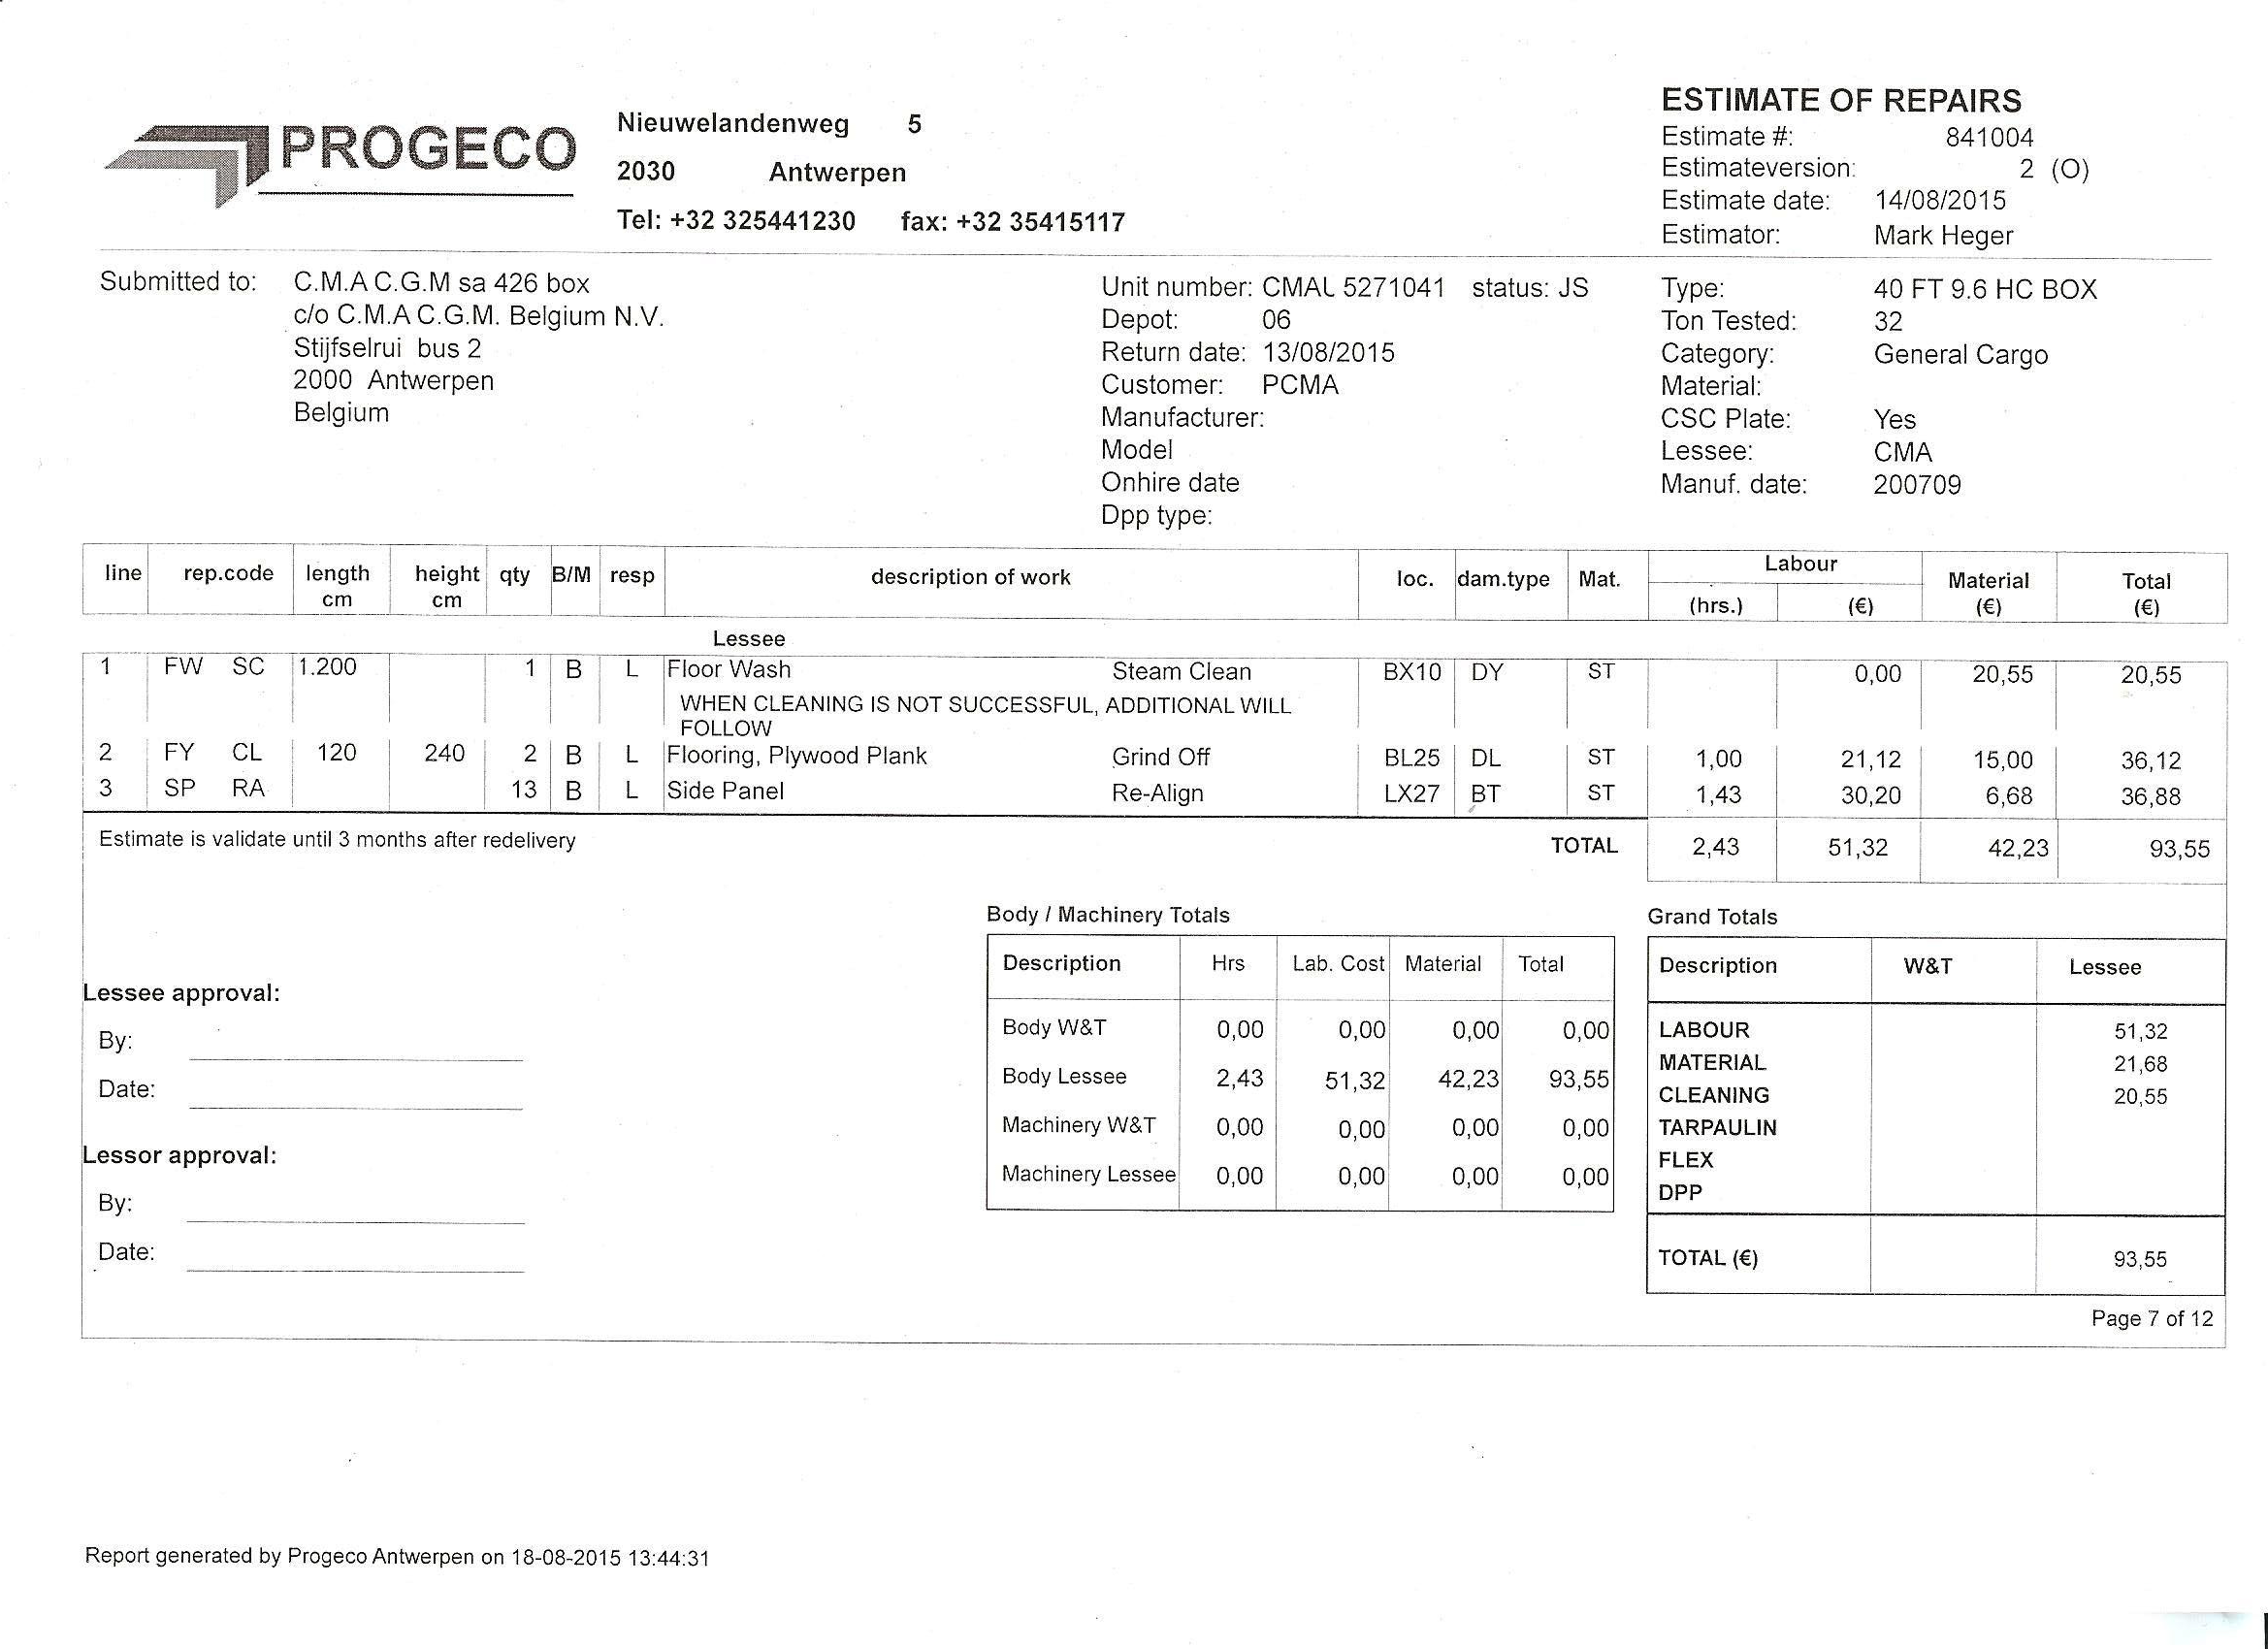
Example of an Estimating form IT based

Slide 98
Spare Parts stockkeeping IT based
Connects perfectly to your repair/estimating activities
Manage your spare parts, the orders, supplier management, locations and administration
directly in your Depot Software.
Integrating your activities on just one location and benefit from it.
Using this module you can directly book spare parts used in repair orders and send
invoices for your sales orders.
Spare Parts module features
Spare Parts stock management
Keep track of stock mutations
Purchase orders
Purchase advice based on minimum stock
Stand-alone sale orders
Supplier management
Import supplier parts catalogs
Track parts per supplier
Cash payment
Automatic stock valuation
Stock location: multiple warehouses
Automatically calculates Average Cost Price (ACP)
Purchase guide & warning pop-ups
Sales agreements per customer
Easily change stock values when counting
Backorders
Barcode scanning

Slide 99
Modules | Interfaces | Apps
Spare Parts module
Image app
Handheld app
Connect the estimate activities with the spare parts module and benefit from putting all
data in just one system.
Create, send & share Photo Reports in just a few clicks with your smart phone or tablet
Connect with a tablet using remote access and put data directly into your system.

Slide 100
Leasing & Trading IT based
Keep track of all activities
Trade your equipment by rental, leasing or selling arranging everything within your Depot
Software Solution. Keeping track of your stock, orders and complete history.
Leasing & Trading module features
Purchase, sales orders & quotes
Fleet management (periodic checks & signals for equipment or drivers)
Manage owned equipment (Containers, chassis, trailers, trucks, etc.)
Keep track of spent costs on equipment
Plan equipment tests and certification
Leasing orders
Keep track of empty, clean & location parameters of equipment
(Batch) Purchase and sales orders
Equipment renting and leasing
Renting and leasing price agreements
Planning boards
Invoices
Upgrade repair order to internal container costs
Keep track of depot history
Manage test dates and certifications

Slide 101
Planning & Transport It based
Keep track of all activities (new module)
With the release of the Planning & Transport Module DEPOT Software also becomes a
full-service solution to Depot Yards with logistic activities and vice-versa.
With this module even more activities can be organized, managed and controlled within
just one software solution.
Planning & Transport module features
Simple equipment/product transports from A to B
Complex equipment/product transport projects (CRM, combine with on-yard services,
external parties)
Fleet management
Equipment combinations
Create orders
Plan services (transport, cleaning, repair, etc.)
Visual plan board (drag & drop)
Keep track of costs (internal, external)
Plan and manage equipment and drivers ( both your own & 3rd party)
Price agreements with customers
Follow-up transports
Declarations
Mileage calculation (free mileage, etc.)
Customs integration (CMR)

Slide 102
Product Storage & Transfer IT based
Keep track of all activities
Manage the storage of products on the yard or terminal, keep track of transfers and all
agreements with your customers.
Storage & Transfer module features
Manage stored products in tanks, containers, IBCs, drums, etc.
Transferring products (from/to land tanks, containers, IBCs, drums, etc.)
Product mixing, sampling and filtering
Price agreements with customers

Slide 103
Safety, Health, Environment & Quality Assurance
Assuring the safety of your staff and the environment, secure processes is a mayor point of attention to every organization. Keeping track of these activities can be a time consuming process.
Especially when your company is ISO or SQAS certified it’s essential to have a good system to log the information.
SHEQ (Non-Conformity and Maintenance) module features
Keep track of manuals and permits
Manage signals determined by date or by scoring counter
Pro-active check warnings & expiration warnings by email
Track status of non-conformities (per customer, haulier, employee, etc.)
Register of complaints, accidents, structural measures, effectively, etc. (ISO)
Insight at any given time

